Slide 1
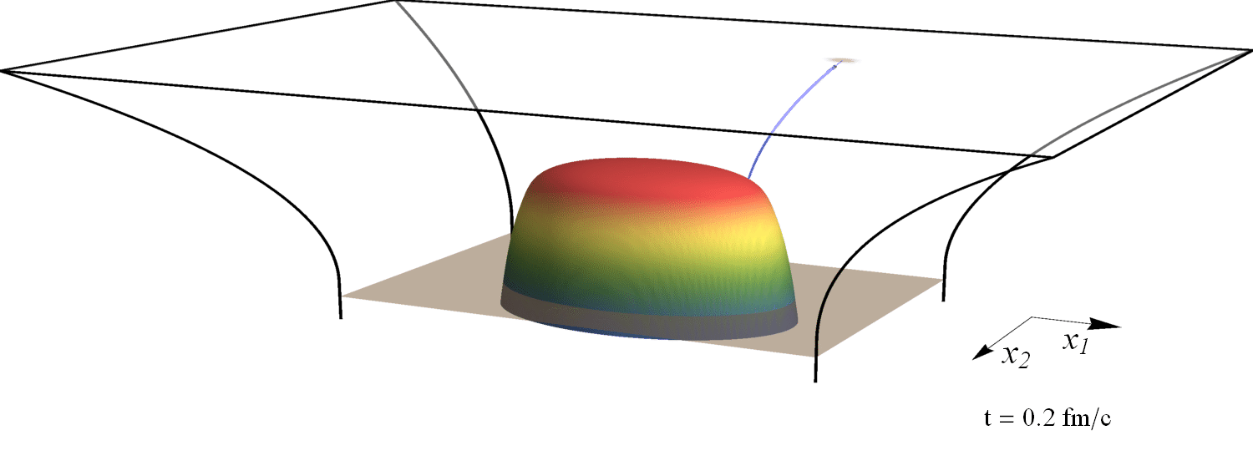
Evolution of the jet opening angle distribution in holographic plasma
Tracking energies and angles
with Krishna Rajagopal and Andrey Sadofyev
1602.04187 (PRL 116)
Wilke van der Schee
NumHol2016
Santiago, 1 July 2016
(slowed down by 10²³)

Slide 2
Outline
Wilke van der Schee, MIT
Motivation, early work and recent progress
Jets as strings and stopping distance
Defining energy loss: finite endpoint momentum string through a slab
A simple model
Construct model of null strings
Evolve ensemble of jets: initial energy & angle from perturbative QCD
Shoot ensemble through expanding and cooling black hole
Extract influence QGP on jet opening angle distribution
A qualitative prediction
Lose both very narrow and very wide jets
Notes:
Many states + linearized

Slide 3
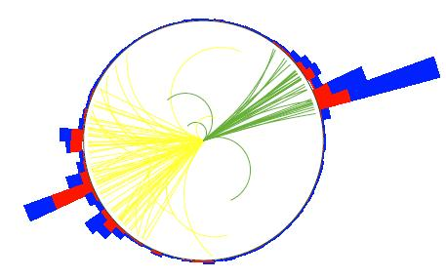
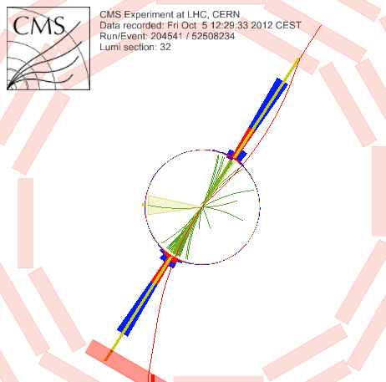
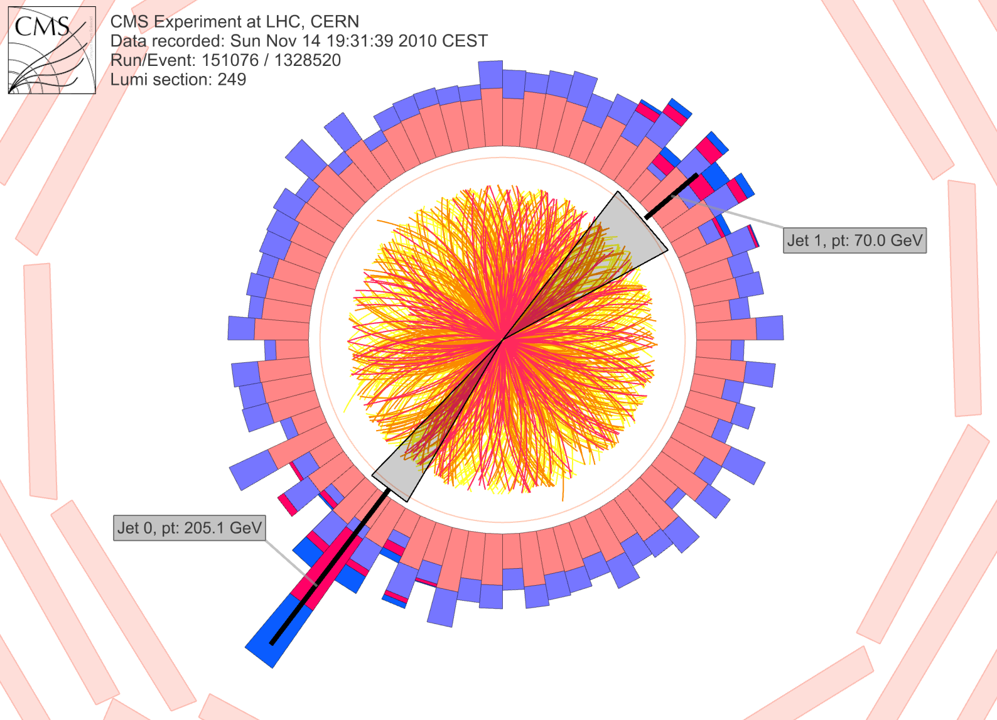
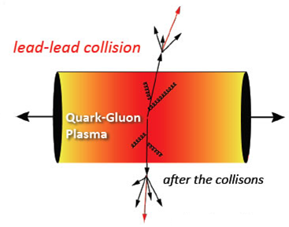
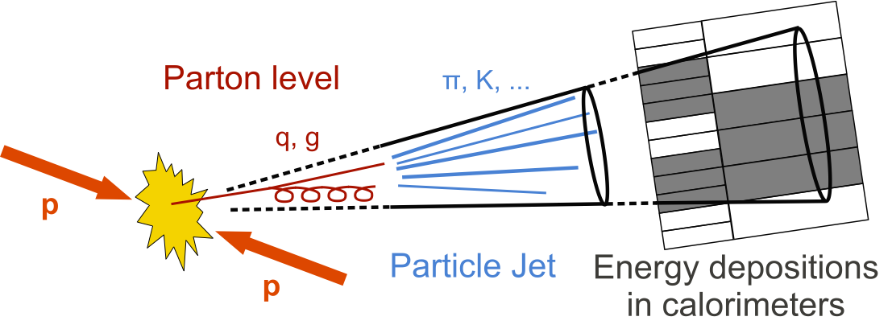
Jets in qgp
Wilke van der Schee, MIT
?
CMS PAPER EXO-12-059
Notes:
Many states + linearized

Slide 4
Olga Evdokimov, presentation Quark Matter 2015, CMS-PAS HIN-15-011

Slide 5
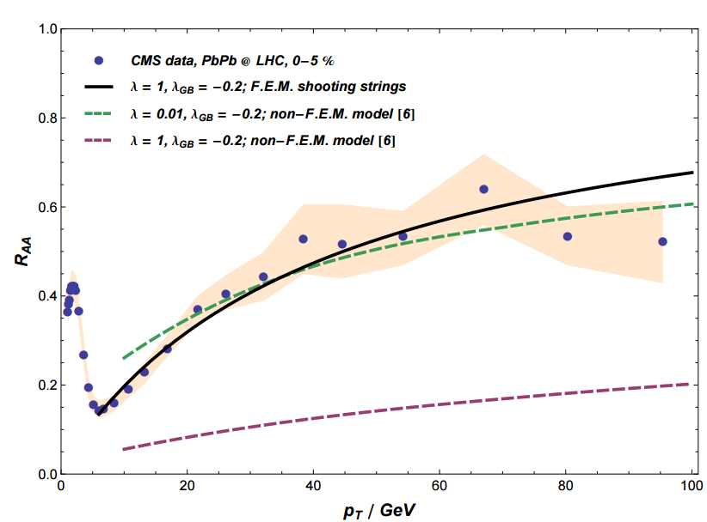
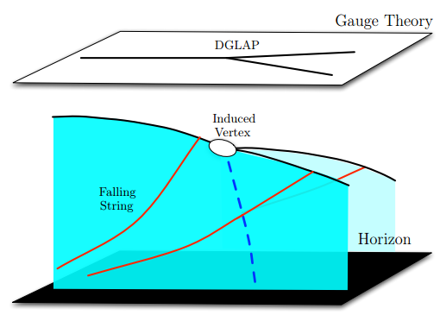
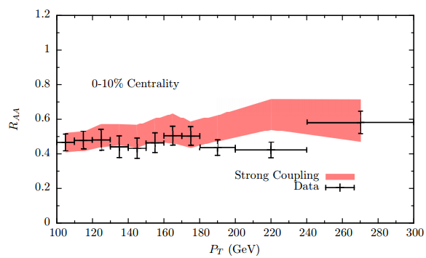
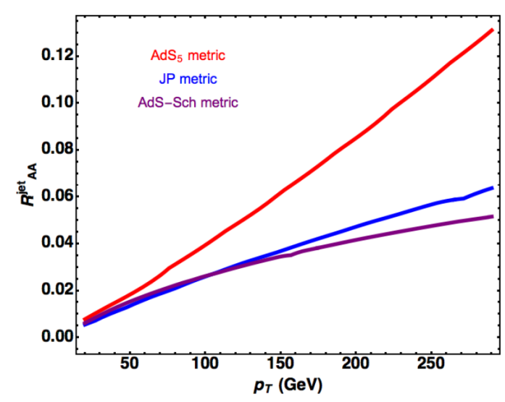
holographic studies with real data
Wilke van der Schee, MIT
J. Casalderrey, D. Can Gulhan, J. Guilherme Milhano, D. Pablos and K. Rajagopal, A Hybrid Strong/Weak Coupling Approach to Jet Quenching
R. Morad, W.A. Horowitz, Strong-coupling Jet Energy Loss from AdS/CFT (2014)
A. Ficnar, S.S. Gubser and M. Gyulassy, Shooting String Holography of Jet Quenching at RHIC and LHC (2013)
Notes:
Many states + linearized

Slide 6
Jet production
Wilke van der Schee, MIT
Typical philosophy:
Jet is result of hard event, as prescribed in pQCD
Energy loss, through soft modes, and non-perturbative
In AdS/CFT: jet = (classical) string
Create string (quark-antiquark pair) with `jet-like’ properties
Problem: initial condition string is 2 functions (position, velocity)
P.M. Chesler, K. Jensen, A. Karch and L.G. Yaffe, Light quark energy loss in strongly-coupled N = 4 supersymmetric Yang-Mills plasma (2008)
Notes:
Many states + linearized

Slide 7
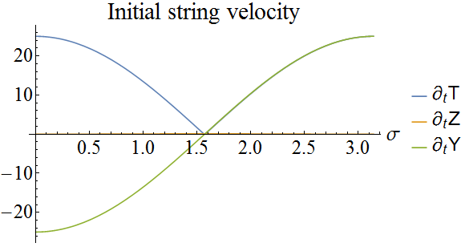
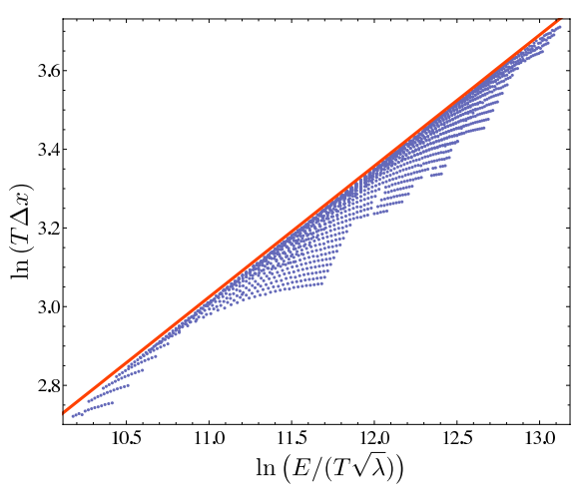
Early work
Wilke van der Schee, MIT
Initial string at point, velocity profile → stopping distance
P.M. Chesler, K. Jensen, A. Karch and L.G. Yaffe, Light quark energy loss in strongly-coupled N = 4 supersymmetric Yang-Mills plasma (2008)
Notes:
Many states + linearized

Slide 8
Energy loss by a slab of plasma
Wilke van der Schee, MIT
Old problem: how to define energy loss in terms of string?
In particular, real jets lose order 10% energy
Natural definition: size black hole = size QGP, shoot jet through
Model evolution more realistically
Part of string falls in black hole: dissipates into hydro modes
Attractive: final string in vacuum AdS is well understood
Angle in AdS ≈ jet angle (?)
P.M. Chesler and K. Rajagopal, Jet quenching in strongly coupled plasma (2014)
Notes:
Many states + linearized

Slide 9
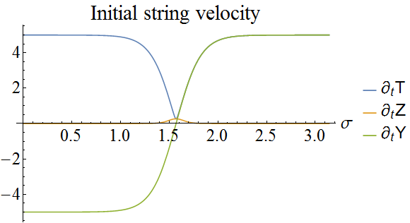
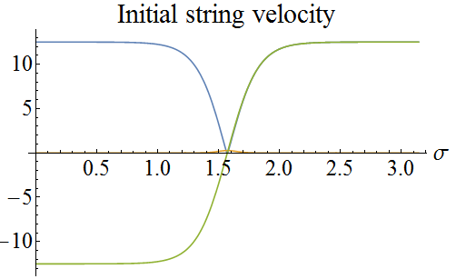
A typical example
Wilke van der Schee, MIT
Try simulate string (regularised finite endpoint string):
Shoot through slab of plasma (or dynamic spacetime)
constant 300 MeV plasma, length 4fm, create at edge
Little bit of freedom: start at 5% from boundary-horizon distance
`t Hooft coupling 5.5, gives jet energy of 1.6 TeV
A. Ficnar and S. Gubser, Finite momentum at string endpoints (2013)
Notes:
Many states + linearized

Slide 10
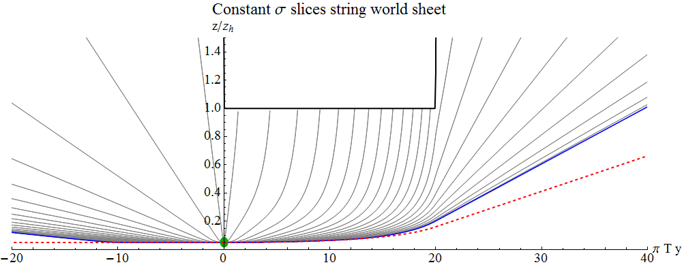
String evolution
Wilke van der Schee, MIT
Black hole
String endpoint (blue) follows null trajectory initially (red dashed)
String endpoints change direction when energy vanishes
`Snapback’: especially relevant when string is moving upwards
Notes:
Many states + linearized

Slide 11
Comments on Numerics
Wilke van der Schee, MIT
Somewhat embarrassing: numerics is simple ☺
NDSolve when speed is not major issue
Method specification is crucial (read advanced tutorial)
Also useful
Make package with general set-up (vacuum, black brane, slab, boost-invariant, shocks etc)
Use Mathematica’s convenience, i.e. can use analytic or Interpolation functions interchangeably
Modular: initial conditions, solve, plot or analyse i.e. three-jet events (see Jorge’s talk)
Notes:
Many states + linearized

Slide 12
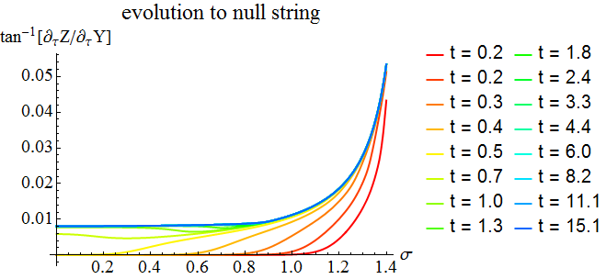
Towards a simpler model
Wilke van der Schee, MIT
Black hole
After a while the string becomes a null string (1 fm/c should be ok?)
Evolution of string = independent evolution of null string segments
Need to know where which string bit goes with how much energy
Notes:
Many states + linearized

Slide 13
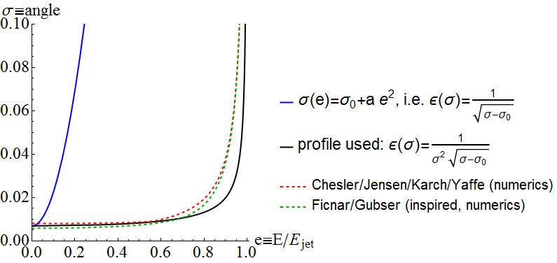
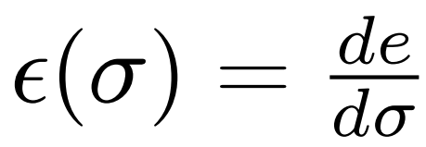
Initial/vacuum Energy profile
Wilke van der Schee, MIT
Need to specify energy along string (change of coordinate (!))
Angle endpoint is positive constant, gives jet width
Open string boundary condition:
Try reasonable profile, perhaps inspired by string numerics
Convert to energy density vs angle:
P.M. Chesler and K. Rajagopal, Jet quenching in strongly coupled plasma (2014)
Notes:
Many states + linearized

Slide 14
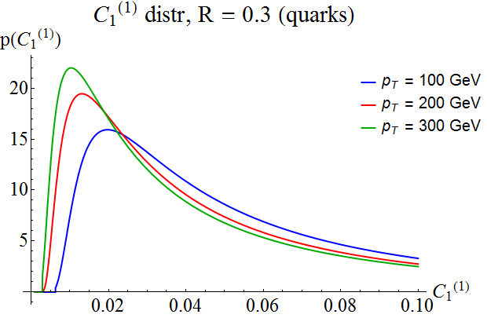
Initial conditions with jet widths
Wilke van der Schee, MIT
Initial conditions in literature: minimize energy loss
Would like to mimic distribution of real QCD jets
Extra motivation: how is distribution affected by QGP?
Take from pQCD (compares well with PYTHIA)
Link opening angle to AdS angle: (a is free)
z_{i}: fraction of jet energy
θ_{ij}: angle between particle i and j
R: jet radius parameter
A.J. Larkoski, S. Marzani, G. Soyez, J. Thaler, Soft drop (2014)
Notes:
Many states + linearized

Slide 15
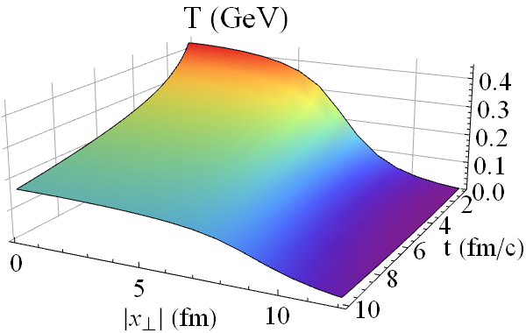
More simplifications
Wilke van der Schee, MIT
Simple semi-analytic hydrodynamic temperature profile:
Neglect initial dynamics (1 fm/c) + hadronization + confinement
Start string at single point at boundary
Distribute according to binary scaling and
Free parameter b: to get reasonably energy loss ((coupling) )
(b measures N_{ch} per S, given EOS)
A. Ficnar, S.S. Gubser and M. Gyulassy, Shooting String Holography of Jet Quenching at RHIC and LHC (2013)
Notes:
Many states + linearized

Slide 16
algorithm
Wilke van der Schee, MIT
Scan parameter space: energy, angle, position, direction
Compute null geodesic endpoint → new angle
Find null geodesic which barely escapes black hole (freeze-out)
→ energy loss
Use original distributions in parameter space
Bin final parameters (energy + angle)
Average over parameter space, taking weight factor
Compare initial with final distributions ☺
Notes:
Many states + linearized

Slide 17
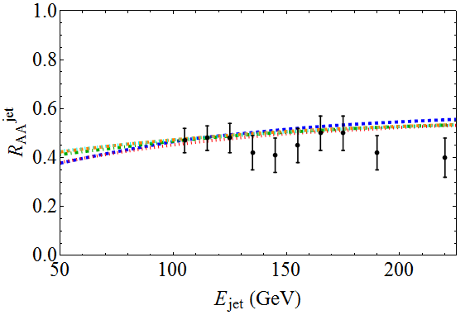
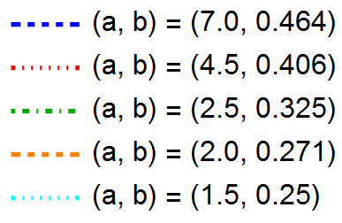
Results
Wilke van der Schee, MIT
Shooting about 50.000 jets through plasma
Naïve QCD:
Notes:
Talk about time running

Slide 18
First effect: jets widen
Wilke van der Schee, MIT
Change of probability distributions of jet opening angle
Has not been measured ☺ (could/should be possible)
Notes:
Many states + linearized

Slide 19
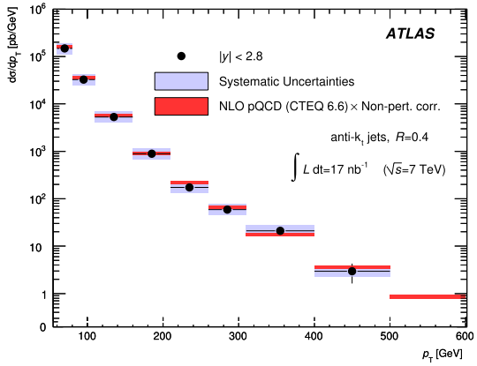
Second effect: Narrower jets
Wilke van der Schee, MIT
Energy distribution falls steeply (~E⁻⁶)
Wide jets lose (much) more energy
→ selection bias on narrow jets
ATLAS, Measurement of inclusive jet and dijet cross sections in proton-proton collisions at 7 TeV centre-of-mass energy (2011)
Notes:
Many states + linearized

Slide 20
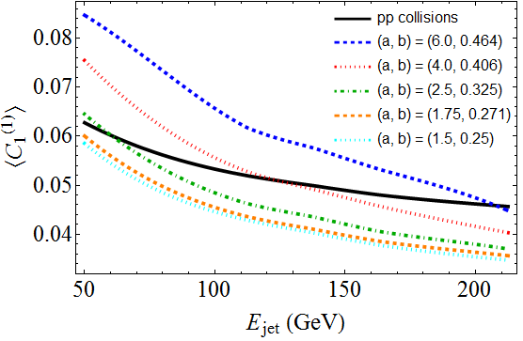
Unclear which effect dominates
Wilke van der Schee, MIT
Average jet width can go up or go down (larger for lower energy)
Notes:
Many states + linearized

Slide 21
Discussion
Wilke van der Schee, MIT
Jets in holographic plasma
Essential to take opening angle distribution in combination with energy
Initial conditions should match those of proton-proton collisions
A qualitative prediction
Each jet gets wider in plasma: narrowest jets are lost
Wide jets lose more energy: widest jets also lost
How to compare N=4 SYM to QCD
How are jets produced? pQCD? Confinement in IR/hadronization?
Naïve comparison with λ≈5.5 seems to fail (?)
Outlook
More quantitative comparisons with experiment, e.g. dijets, off-central, more substructure, jet shape
Real (finite endpoint) string dynamics? Match to null string?
Finite coupling corrections in more realistic settings? Perhaps less fitting?
Notes:
Many states + linearized

Slide 22
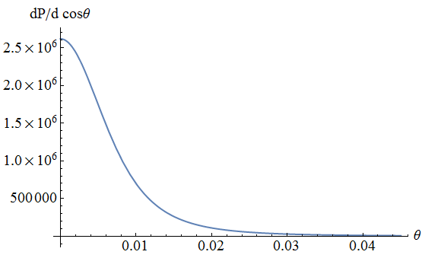
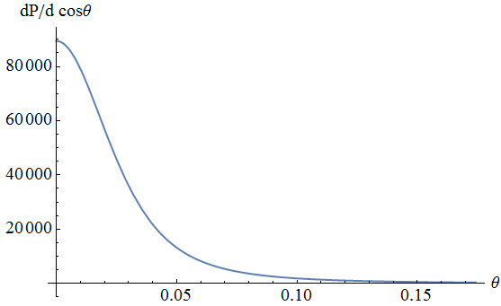
Jet angular spectrum
Wilke van der Schee, MIT
At late times string falls into AdS, straight lines for each σ.
Stress-energy on boundary due to `collection of AdS point particles’: energy e, angle to center θ, AdS angle α
Left:
876 GeV (7% loss)
angle ~ 0.01
Right:
462 GeV (52% loss)
angle ~ 0.04
Y. Hatta, E. Iancu, A. Mueller and D. Triantafyllopoulos, Aspects of the UV/IR correspondence: energy broadening and string fluctuations (2010)
Notes:
Many states + linearized

