Slide 1
Simulating Yang-Mills in 9+1 dimensions
Paul Romatschke
University of Colorado, Boulder & CTQM

Slide 2

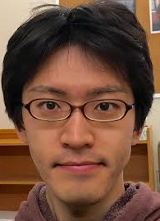


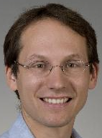

Hunting for Quasi-Normal Modes in Cold Atoms

Slide 3
Hunting for Quasi-Normal Modes in Cold Atoms
Please see 1605.00014 or talk to us if you’re interested in this topic!

Slide 4
Simulating Yang-Mills in 9+1 dimensions

Slide 5

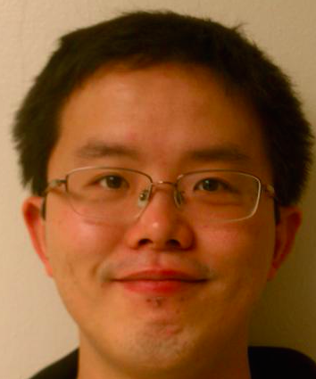


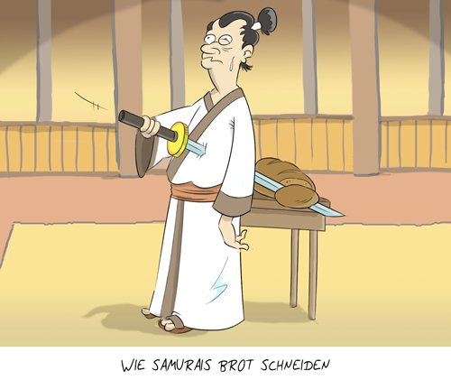
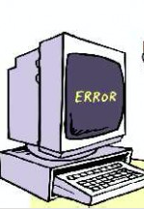
Simulating Yang-Mills in 9+1 dimensions
Don’t worry,
he is just
simulating!

Slide 6
Outline of the Talk
Motivation
more Motivation
Motivation by showing other people’s results
Work in Progress
Summary & Conclusions
Ample time, feel free to ask questions!

Slide 7
Motivation

Slide 8
Gauge-Gravity Duality
IIB string theory on AdS₅xS₅ <-> N=4 SYM on M₄
M theory on AdS₄xS₇ <-> ABJM theory on M₃
Dualities are expected to hold for arbitrary coupling/number of colors

Slide 9

Gauge-Gravity Duality
IIB string theory on AdS₅xS₅ <-> N=4 SYM on M₄
N=4 SYM on M₄ is ‘complicated’:
‘Parent’ theory N=1 SYM on M₁₀ is much simpler:
You get back N=4 SYM if you compactify Minkowski₁₀ on a 6-torus

Slide 10
Gauge-Gravity Duality
‘Parent’ theory N=1 SYM on M₁₀ is much simpler:
Expect this theory to be (exactly) dual to string theory in 10 dimensions
Mostly use weakly coupled string theory to tell us about strongly coupled gauge theory
In this talk: use weakly coupled gauge theory to tell us about full string theory in 10 dimension!

Slide 11
Simulating String Theory in 10 dimensions
Why would you want to do such a thing?
Possible reasons:
Because we can!
Because we can study quantum gravity (in 10d)
Because we can study black hole evaporation and endpoint of Gregory-Laflamme instability
…

Slide 12
Simulating String Theory in 10d
Parent Theory:
First steps: compactify parent theory on T₉ and get matrix model
Derivatives along compact dimensions vanish: ∂_{I} → 0
F_{IJ}=∂_{I} A_{J}- ∂_{J} A_{I}+[A_{I},A_{J}] → [A_{I},A_{J}]; call A_{I} new name X_{I}
X_{I} is NxN matrix

Slide 13

Simulating String Theory in 10d
10d N=1 SYM compactified on T₉:
This Lagrangian is thought to describe quantum mechanics of D0 branes on the gravity side
[Banks et al. PRD55 (1997); Berkowitz et al. 1606.04951]

Slide 14

How does this work?
Consider one of the X^{M}, which is an NxN matrix
X^{M} contains information about N D0 branes
For instance, if one D0 brane is not interacting with any of the other (N-1) D0 branes, then one expects X^{M} to take on a block diagonal form
where x^{M} would be interpreted the Mth coordinate of the D0 brane in a 9 dimensional space

Slide 15
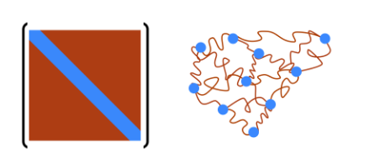
How does this work?
This leads to the interpretation that the diagonal entries of X^{M} are associated with the location of the D0 branes and the off-diagonal entries are strings connecting those D0 branes
[Berkowitz, Handa, Maltz, 1603.03055]

Slide 16
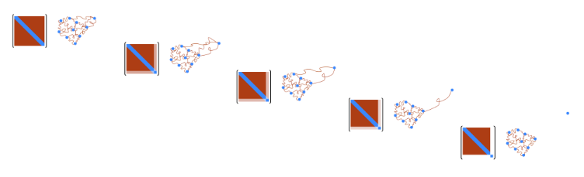
Hawking radiation in string theory
By monitoring structure of matrices, one could hope to see a D0 brane exiting the BH union (“D0xit”)
[Berkowitz, Handa, Maltz, 1603.03055]

Slide 17
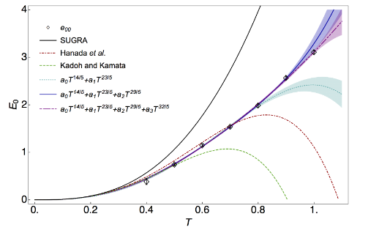
Tests: BH internal energy vs. SUGRA
[Berkowitz et al. 1606.04951]

Slide 18
Getting started
Black hole/Black string transitions in 1+1d

Slide 19
Black hole/Black string transitions
Consider N=1 SYM on a spatial circle with length r_{x}
Consider finite temperature T; temporal length r_{T}=T⁻¹
8 other dimensions compactified → 2 gauge fields A_{t}, A_{x}, 8 scalars

Slide 20
Bosonic (high temperature) limit
N=1 SYM :
At finite temperature T, fields characterized by Matsubara modes ω
Bosonic ω_{n}=2 π T n
Fermionic ω_{n}=2 π T (n+1/2)
At large T, fermions become very heavy and decouple
Considering only gauge fields is good approximation

Slide 21


Wilson loop
Spatial Wilson loop (gauge invariant!)
Can look at eigenvalue distributions of P_{x}-> diag(e^{iλ}), λ ℇ [-π, π]
Can look at expectation value
First for matrix model limit (r_{x}→0) [Aharony et al, 0406210]

Slide 22
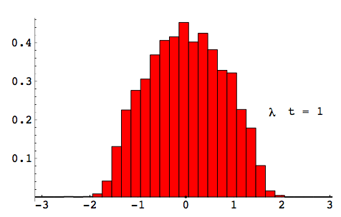
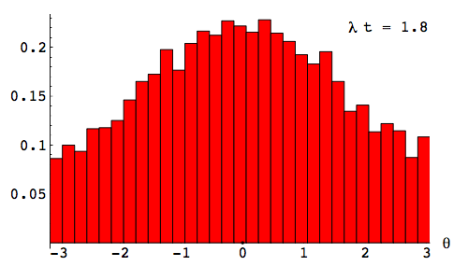
Wilson loop Eigenvalue distributions for 0+1d
Low temperature, Black hole
High temperature, Black string
[Aharaony et al, 0406210]
Below critical temperature, black string unstable to GL instability (phase transition)

Slide 23
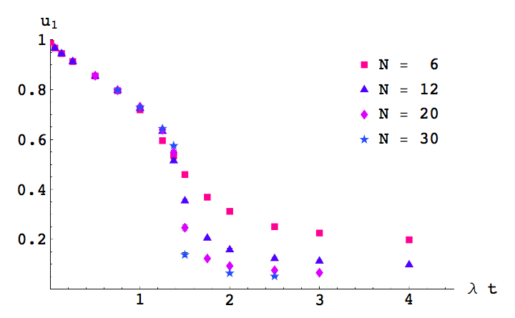
Wilson loop expectation value in 0+1d
[Aharaony et al, 0406210]

Slide 24
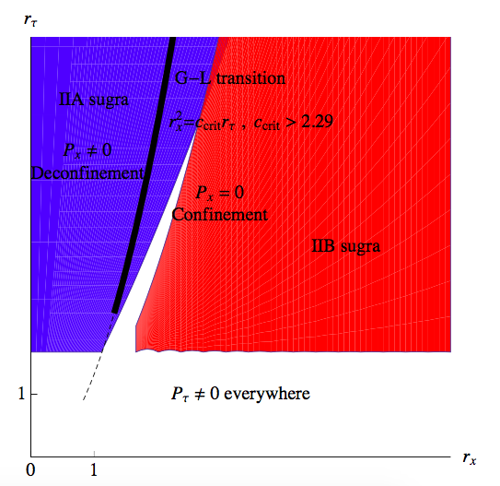
From 0+1 to 1+1
Expected phase diagram as a function of circle length r_{x} and inverse temperature r_{t}
Large temperature (small rt): Black string
Small temperature (large rt): Black hole
<P_{x}> is order parameter
[Wiseman et al, 1008.4964]

Slide 25
Technique

Slide 26
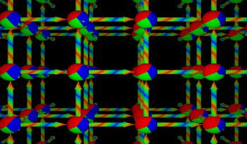
Lattice Gauge Theory
Lattice gauge theory: discretize space on a (hyper)-cubic grid with lattice spacing a
Differentials get replaced by finite differences
Maintain gauge invariance: use link variables U(x) instead of gauge field A(x)
Mostly: Euclidean formulation (imaginary time)+importance sampling (Monte-Carlo) to evaluate Z=∫e^{-S}

Slide 27
High temperature (classical) limit
Effective 2d Yang-Mills coupling g²_{(2d)} is dimensionful
At finite temperature, effective coupling is
g²_{(2d)} T⁻²
High temperature limit T>>1 corresponds to weak coupling
At large T, dynamics is dominated by weak coupling limit
Considering classical Yang-Mills is reasonable approximation

Slide 28
Simulating Classical YM+8 scalars in 1+1 dimensions
At large T, considering classical Yang-Mills is good approximation to N=1 SYM
Bonus: we know how to simulate classical Yang-Mills (CYM) in real-time [Amjoern et al. ‘90; Krasnitz & Venugopalan ‘99]
9d lattice: nx1⁸ lattice sites
n a=rx is length of spatial circle
Other 8 dimensions are length a -> shrink to 0 in continuum limit
No need to introduce scalars explicitly, just compactify pure YM
Very different from traditional lattice gauge theory!

Slide 29


Simulating CYM on the lattice
A_{t}=0 gauge: Hamiltonian density
Gauge fields on the lattice
Magnetic energy density
Evolve electric fields E_{i} and gauge links U_{i} in real time on the lattice

Slide 30
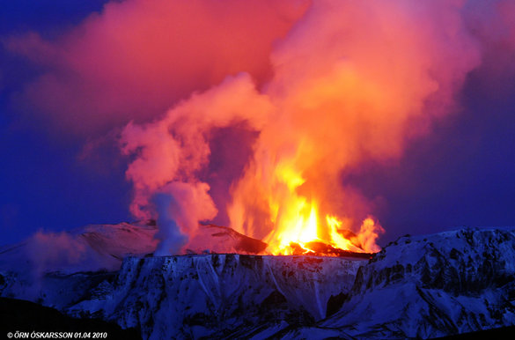

Classical Yang Mills SU(N) Code in arbitrary d
Codename “Katla”
C/C++
Uses gsl & Eigen C
libraries
Will be made public
and available for
download

Slide 31
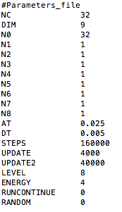
Advantages
Arbitrary number of large dimensions
Arbitrary number of scalars (compactified dimensions)
Real time
Proven technology (EW physics, QCD Plasma Instabilities)
Unconditionally & long-time stable simulation
Master parameter file of Katla

Slide 32
Disadvantages
No fermions
Classical limit:
  Breaks down at low T
  Breaks down at large k
Jeans UV catastrophy
  No classical equilibrium (simulation hits lattice UV cutoff in finite time)
  Can only trust simulations until t_{UV} (can be increased by decreasing a)
Microcanonical ensemble: fix energy E, not temperature T
  I do not know how to unambiguously measure T in simulations

Slide 33
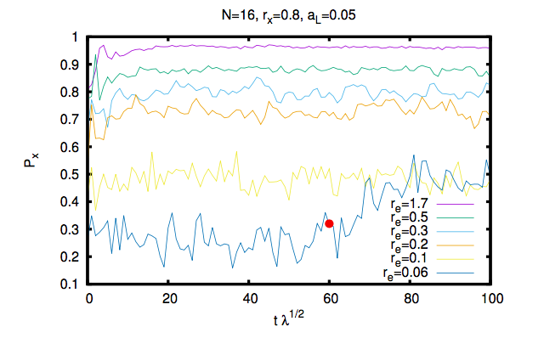
Results: time dependence of Wilson loop
Thermal fluctuations of Wilson loop increase with higher energy (lower r_{e})

Slide 34
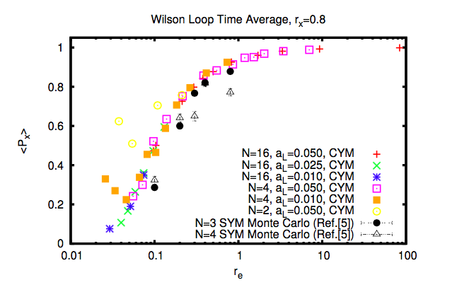
Results: time average of Wilson loop
Katla results agree remarkably well with full SYM.
No hints of phase transition as function of energy.
BH phase
BS phase

Slide 35
Results: distribution of Wilson loop eigenvalues
Low temperature, Black hole
High temperature, Black string

Slide 36
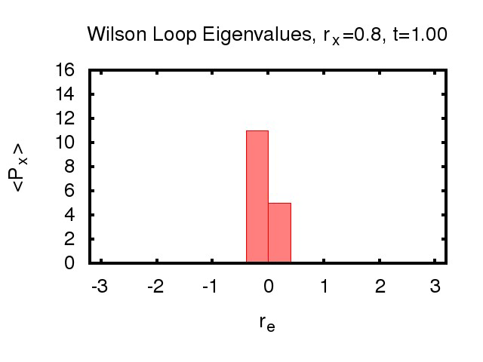
Real time evolution of Wilson loop eigenvalues

Slide 37
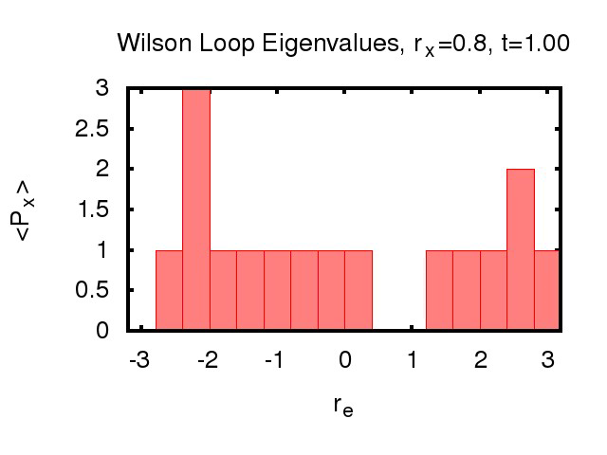
Real time evolution of Wilson loop eigenvalues

Slide 38
Quenches
Let system equilibrate at some energy (temperature)
Then rapidly change electric fields
System needs to migrate to a new equilibrium state

Slide 39
Quenches: Wilson loop expectation value
After quench <Px> relaxes to new equilibrium
Approach to new eq. exponential?
Can measure rate!

Slide 40
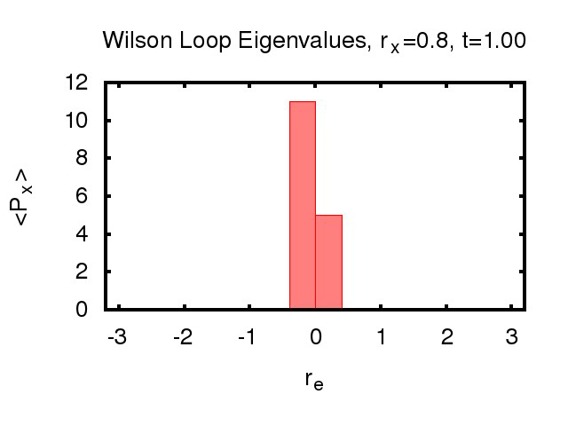
Quenches
Rapidly change
temperature (up)
at t=50

Slide 41
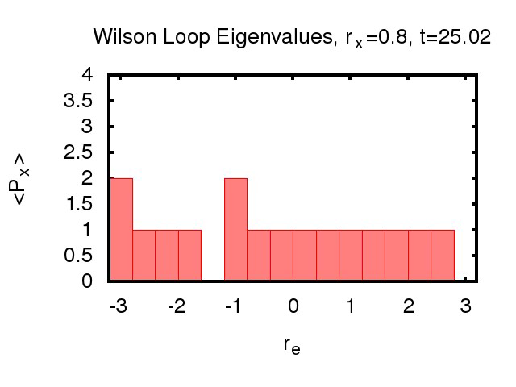
Quench: Gregory-Laflamme breaking black string

Slide 42
Summary and Conclusion
Simulating classical YM in 1+1+8d is easy and fun
For some things it seems to be working better than expected (agreement with full SYM for low temperature Wilson loop)
There are new things one can study (GL instability in real time)
There are some puzzles (why no hint of phase transition as N increased)
There are some problems (how to measure temperature)
There are some things one can do better (include fermions, include HL)
The CYM code will be made public, download and play yourself:
http://hep.itp.tuwien.ac.at/~paulrom/

Slide 43
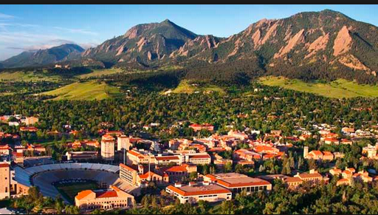
Postdoc Applications Welcome!
CU ‘Nuclear’ group expects to open postdoc position for Fall’17
Applications welcome (also after Jan 7!)

Slide 44
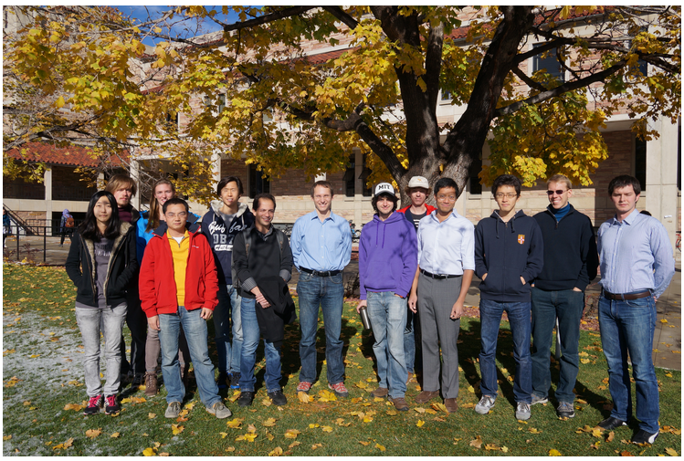
Strongly Coupled Fluids Group @ CU Boulder

