Slide 1


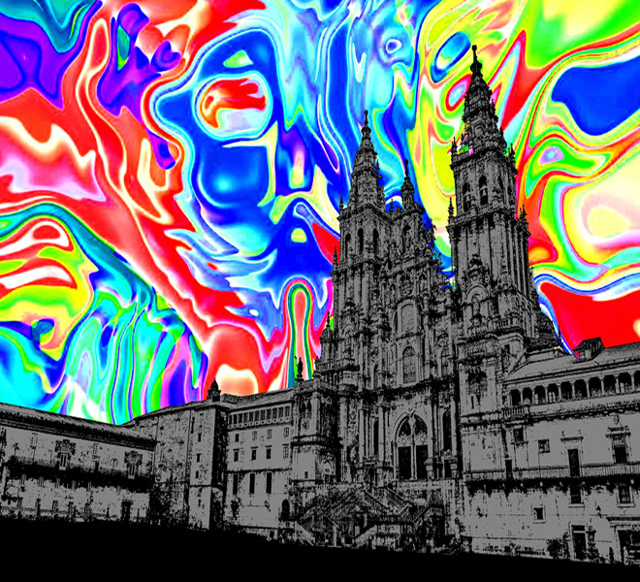
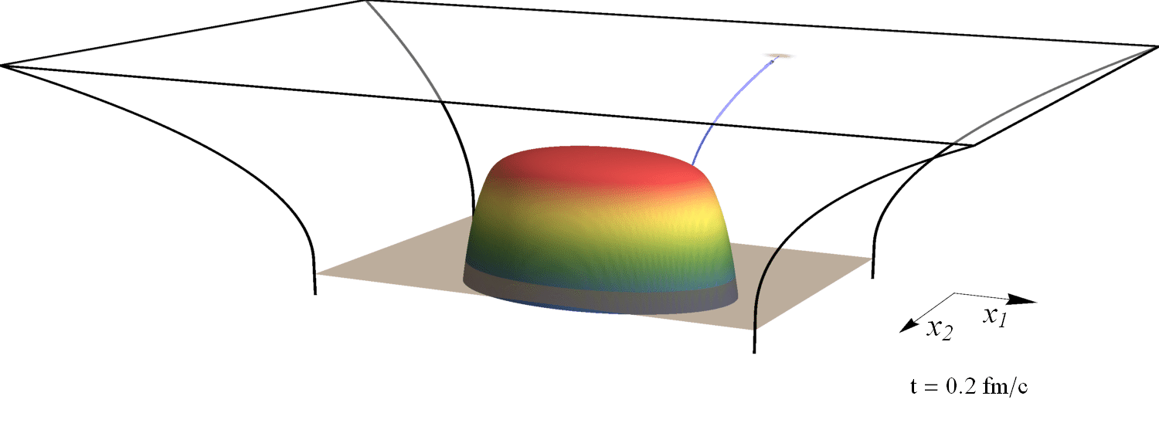
Jet energy loss in a flowing plasma
Combining QCD, strings, null geodesics and viscous hydro
With Jasmine Brewer, Krishna Rajagopal and Andrey Sadofyev
1602.04187 (PRL), 1710.03237 and to appear
Wilke van der Schee
HoloQuark 2018
Santiago de Compostela, 4 July 2018
(slowed down by 10²³)

Slide 2
Outline
Wilke van der Schee, MIT/Utrecht
Motivation, early work and recent progress
  (weakly coupled) jet energy interacts strongly with QGP
  Succesfully matches observations in hybrid model
  From production (pQCD) to strings to null geodesics in AdS
A simple model
  Two simple examples: energy loss has memory
  Null geodesics in viscous hydrodynamics: formula + subtlety
  Going with or against the flow
  Jet shapes & temperature dependence in Gubser flow
Preliminary results and an easy implementation
  Goal is to provide energy loss formalism valid for flowing plasma
Notes:
Many states + linearized

Slide 3
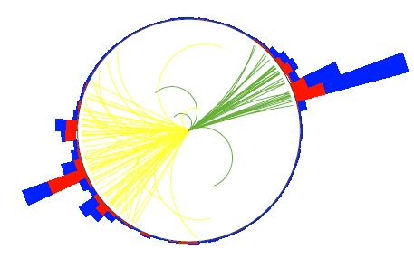
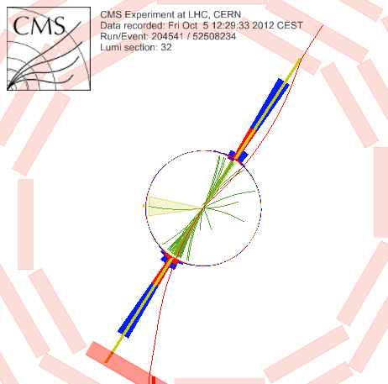
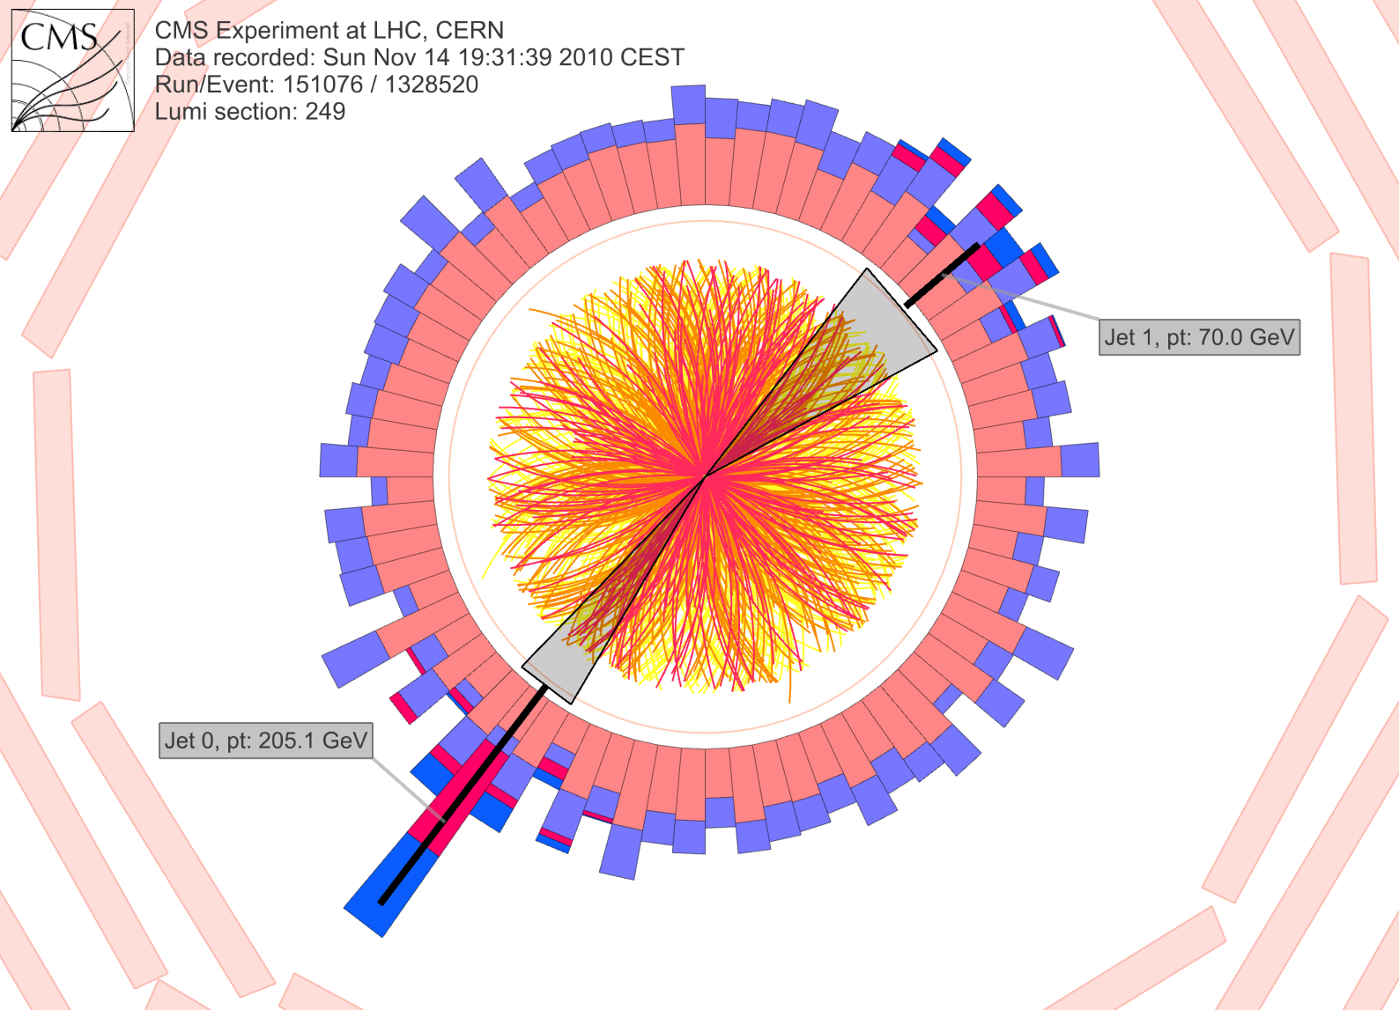
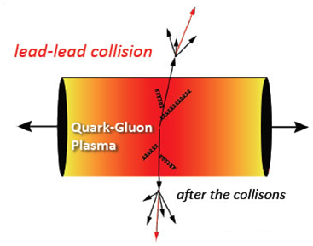
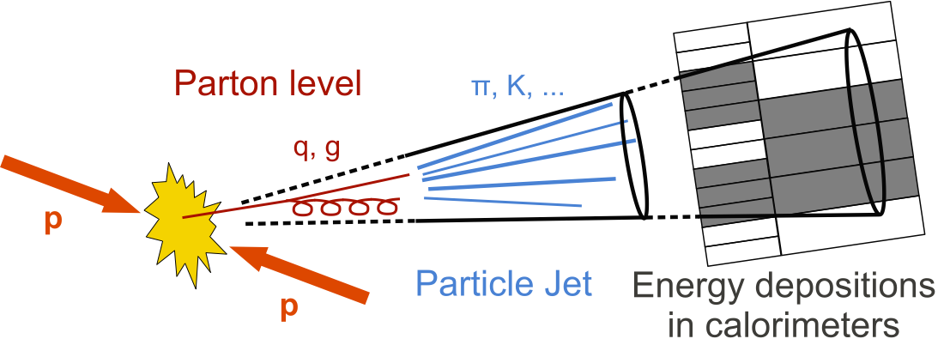
Jets in qgp
Wilke van der Schee, MIT/Utrecht
?
CMS PAPER EXO-12-059
Notes:
Many states + linearized

Slide 4
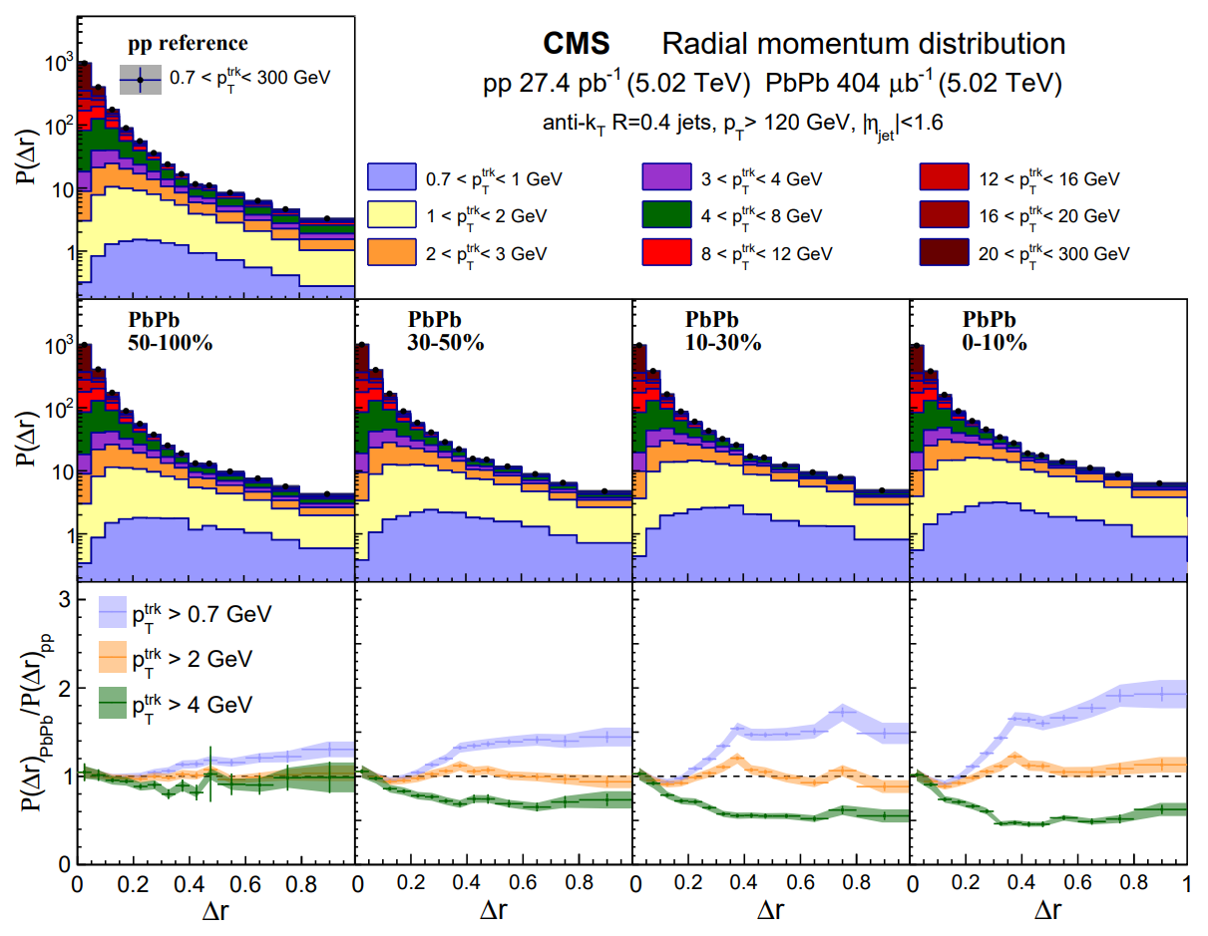
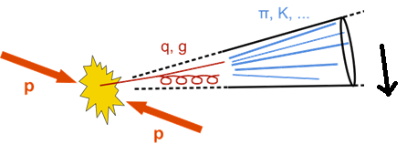

Wilke van der Schee, MIT/Utrecht
Trends in jet analysis
CMS, Jet properties in PbPb and pp collisions at √s_{NN} = 5.02 TeV (2018)

Slide 5
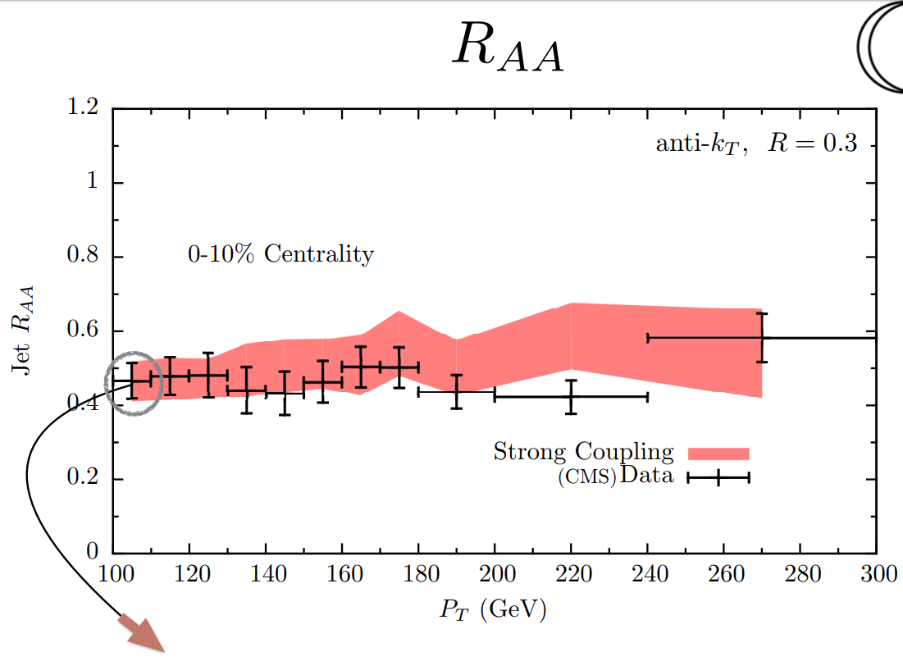
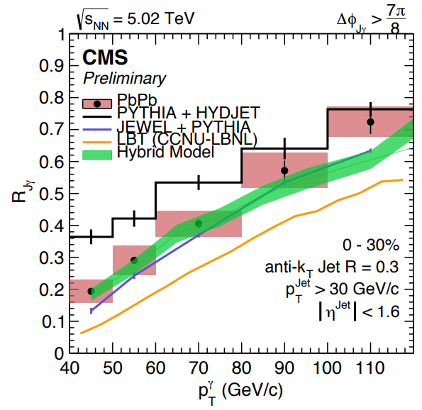
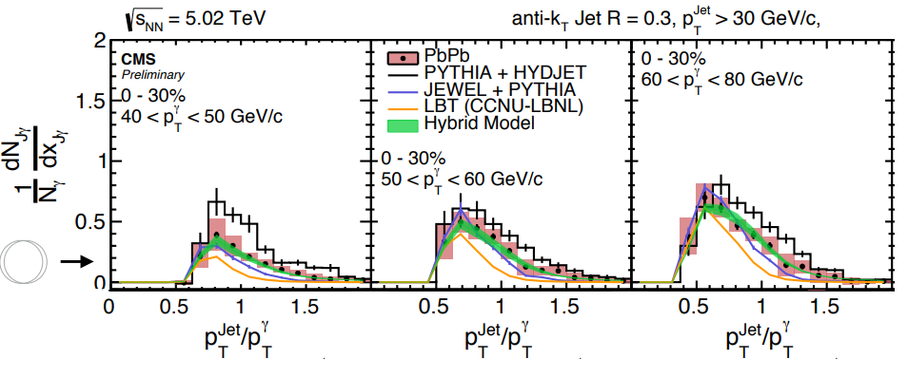
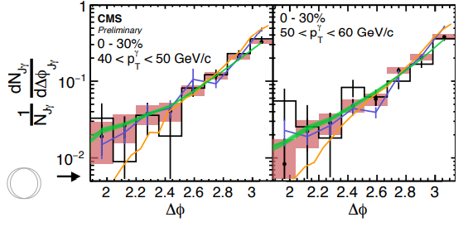
Ads/cft inspired model works:
Wilke van der Schee, MIT/Utrecht
One parameter fitted
J. Casalderrey, D. Can Gulhan, J. Guilherme Milhano, D. Pablos and K. Rajagopal, A Hybrid Strong/Weak Coupling Approach to Jet Quenching
K. Rajagopal, Presentation Quark Matter 2017
Notes:
Many states + linearized

Slide 6
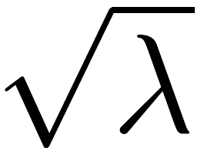
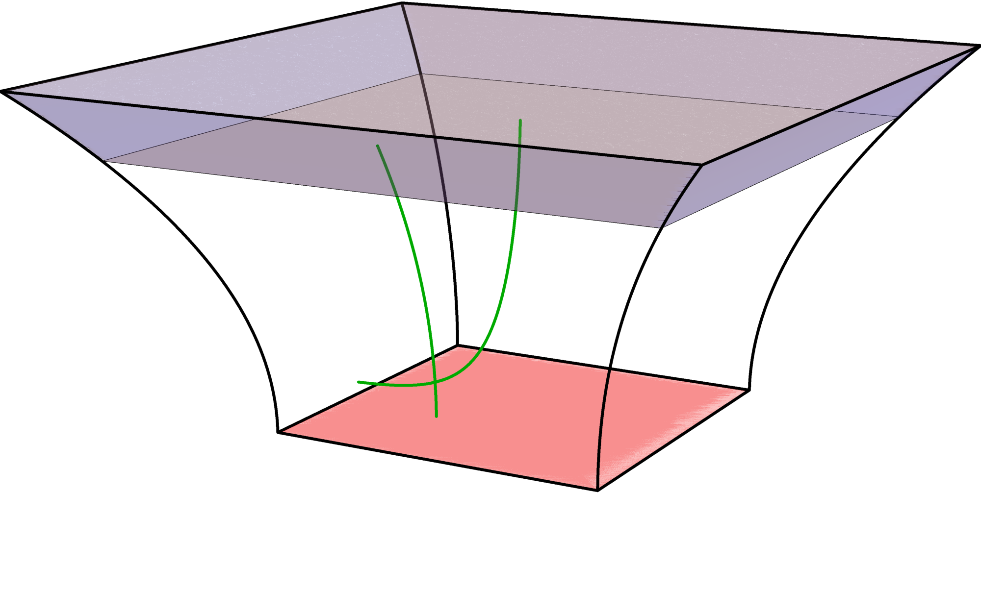

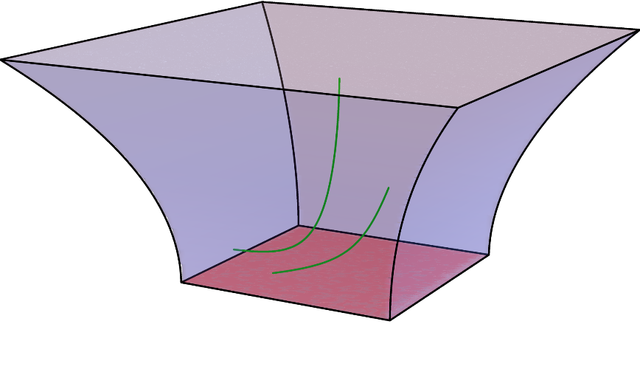


Quarks in ads/cft
Wilke van der Schee, MIT/Utrecht
AdS/CFT allows to add fundamental quarks to N=4 SYM
  Classical open strings, but energy proportional to
Endpoint has to stay on D7-brane, cannot fall
Light quarks; strings falls into black hole
Heavy quarks, if mass>temperature
Andreas Karch and Emanuel Katz, Adding flavor to AdS/CFT (2002)
Notes:
Many states + linearized

Slide 7
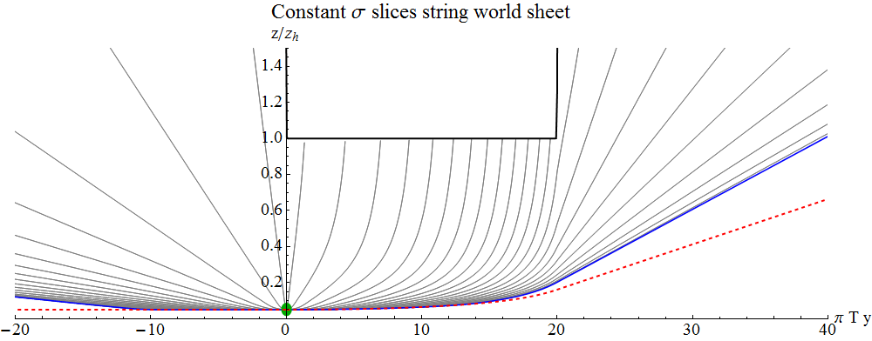
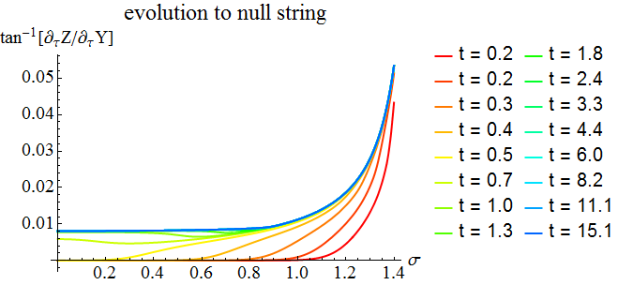
Towards a null string
Wilke van der Schee, MIT/Utrecht
Black hole
After a while the string becomes a null string (1 fm/c should be ok?)
Evolution of string = independent evolution of null string segments
  Need to know where which string bit goes with how much energy
Notes:
Many states + linearized

Slide 8
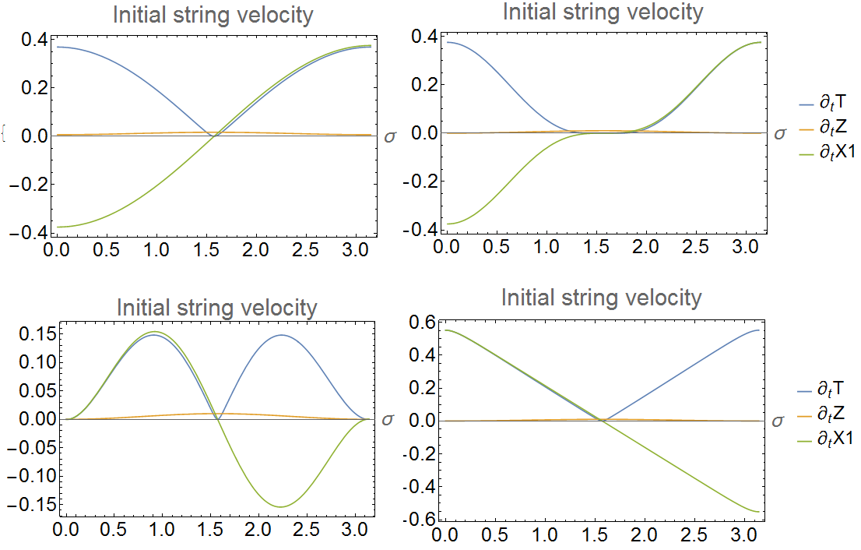
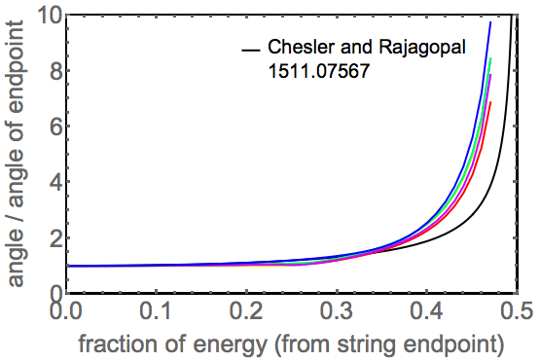
String profile
Wilke van der Schee, MIT/Utrecht
Back-to-back string evolution
  Try several initial profiles
  Endpoint angle and energy determine profile
  Can change when considering 3D evolution (Andrey)
  This can reasonably model a single jet, with opening angle determined by C₁⁽¹⁾
Notes:
Many states + linearized

Slide 9

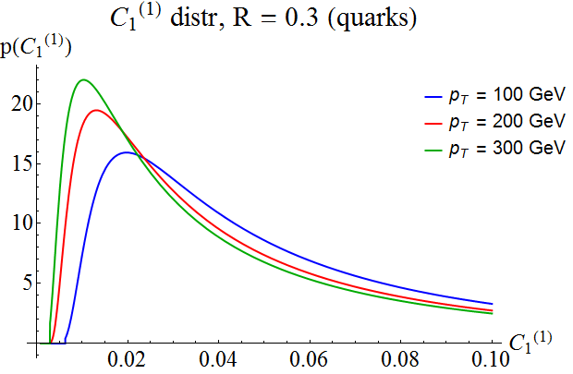
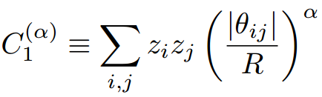

Initial conditions with jet widths
Wilke van der Schee, MIT/Utrecht
Would like to mimic distribution of real QCD jets
  Extra motivation: how is distribution affected by QGP?
  Take from pQCD (compares quite well with PYTHIA)
Link opening angle to AdS angle: (a fixed next)
z_{i}: fraction of jet energy
θ_{ij}: angle between particle i and j
R: jet radius parameter
A.J. Larkoski, S. Marzani, G. Soyez, J. Thaler, Soft drop (2014)
Notes:
Many states + linearized

Slide 10
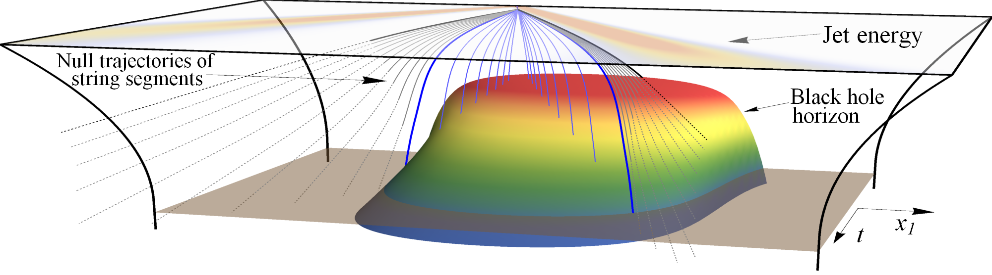
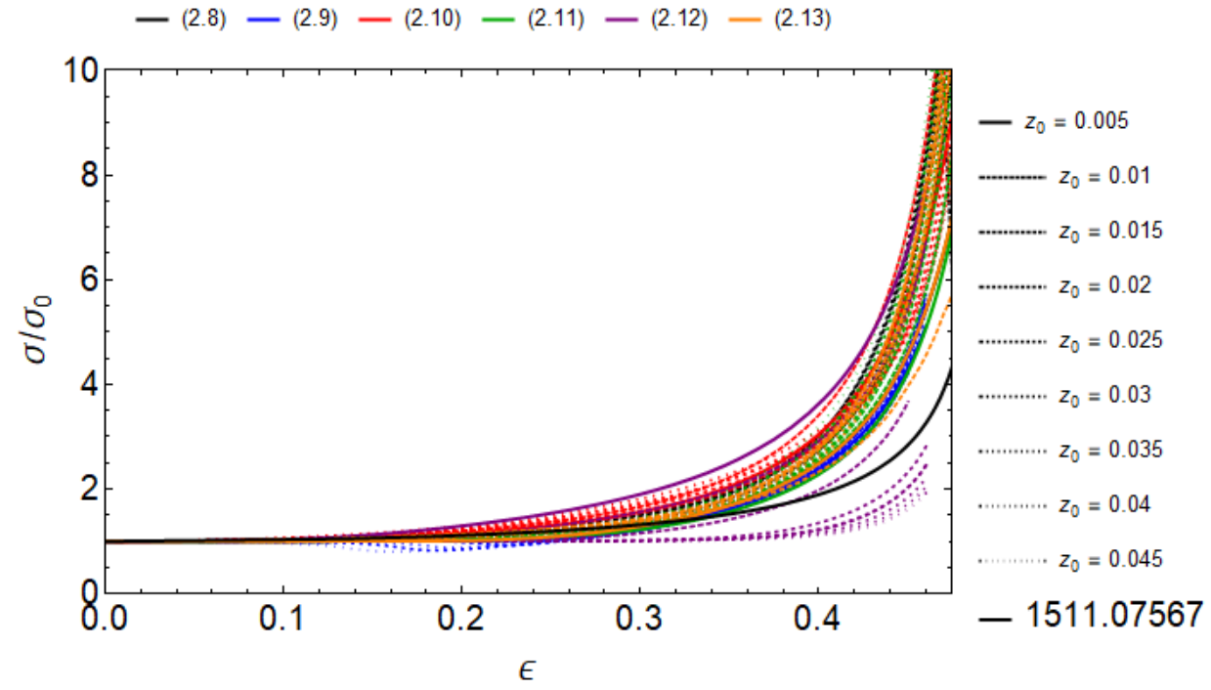
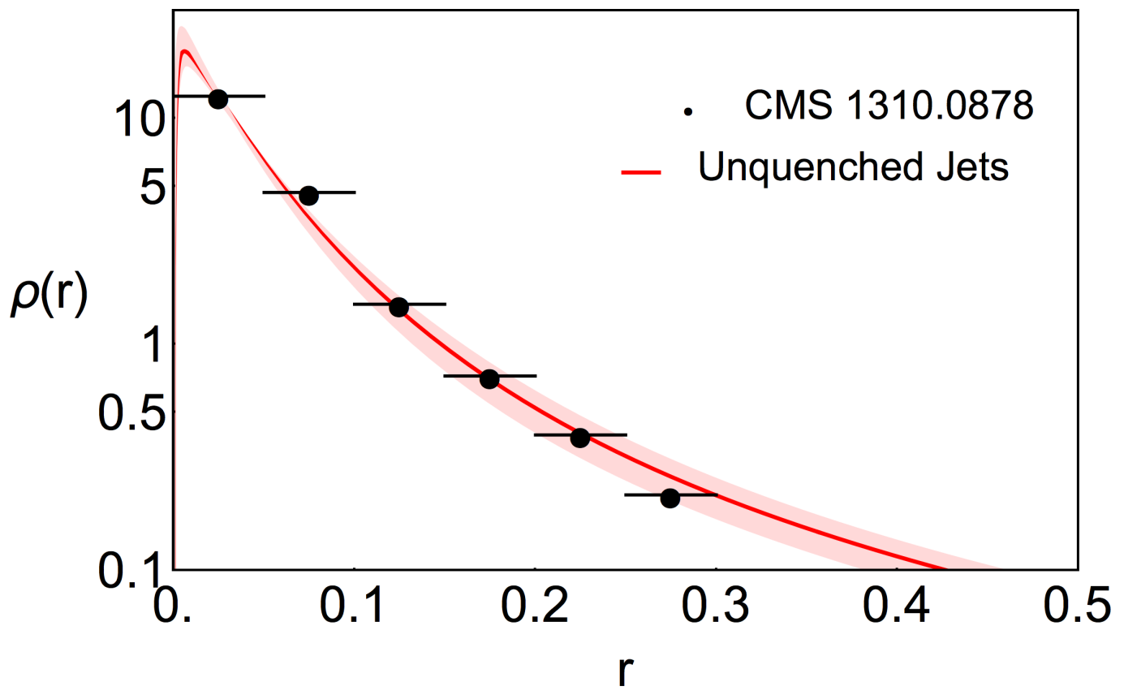
Jet energy loss in ads/cft
Wilke van der Schee, MIT/Utrecht
Leads to (simplified) model for jet evolution
  String segments quickly follow null geodesics in semi-universal way
  Possible to track null geodesics falling in: determines energy loss
  (analytic formula for specific case, also assuming constant T)
J. Brewer, K. Rajagopal, A. Sadofyev and WS, Jet shape modification in a holographic plasma (2017)
Notes:
Talk about time running

Slide 11
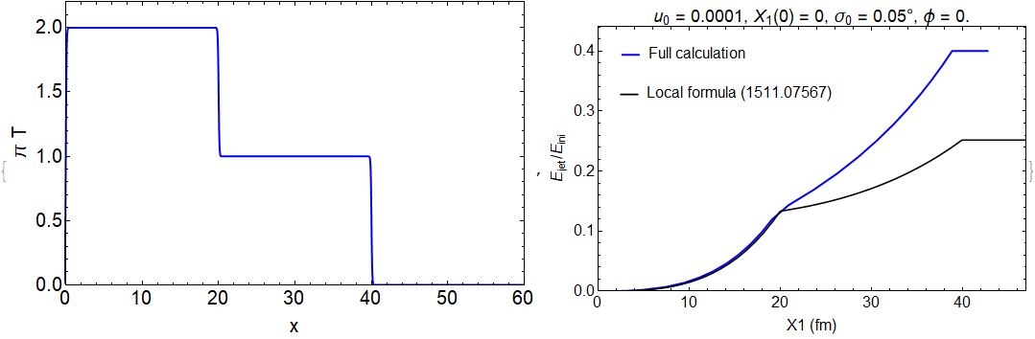
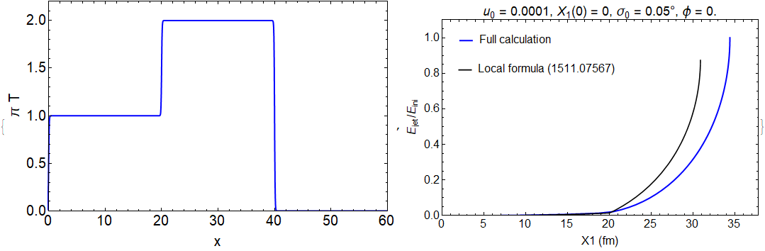
Varying temperature
Wilke van der Schee, MIT/Utrecht
Energy loss depends on temperature evolution non-linearly:
  First phase agrees with (ultra)local formula (Chesler, Rajagopal)
  Interesting: (final) energy loss much bigger for 2nd profile
  Illustrates `memory-effect’: wave function remembers evolution
Notes:
Many states + linearized

Slide 12
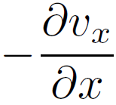
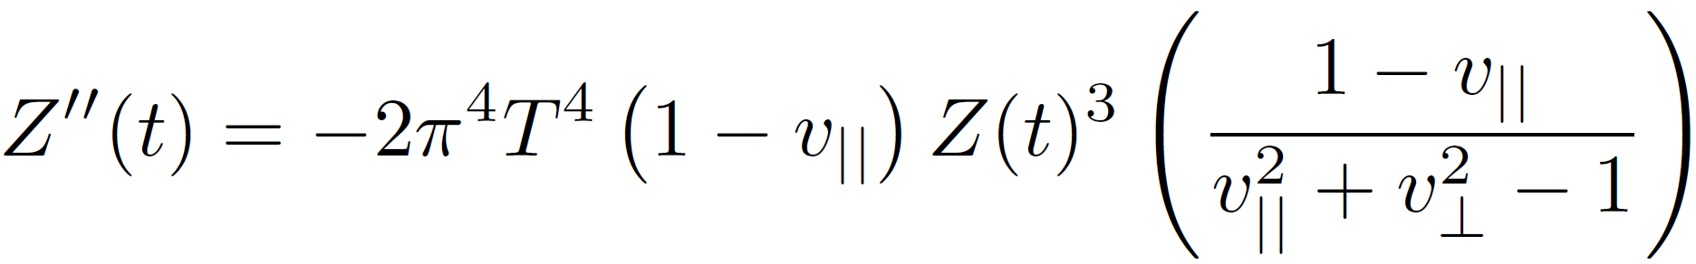
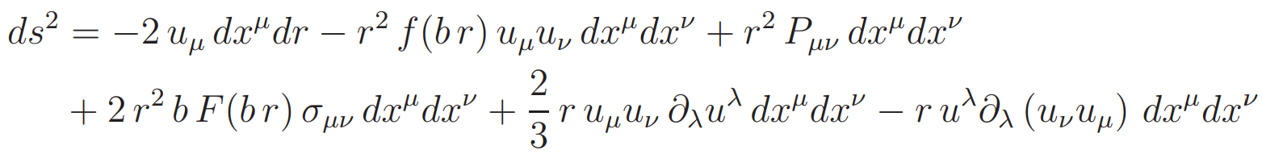
Second effect: Flow
Wilke van der Schee, MIT/Utrecht
Flow has not yet been included
  Subtlety in geodesic equation from metric using ideal hydrodynamics:
    Geodesic equation contains derivatives of metric
    Includes a term ~ , to be compared with Z³ (typically very small)
  Two solutions: use viscous hydrodynamics (term cancels), or ignore gradients on level of geodesic equation (as opposed to metric, easier)
Final formula for geodesics in ideal hydrodynamics:
(full formula including Z’ and viscous terms is known but longer)
Sayantani Bhattacharyya, Veronika Hubeny, Shiraz Minwalla and Mukund Rangamani, Nonlinear Fluid Dynamics from Gravity (2007)
Notes:
Many states + linearized

Slide 13
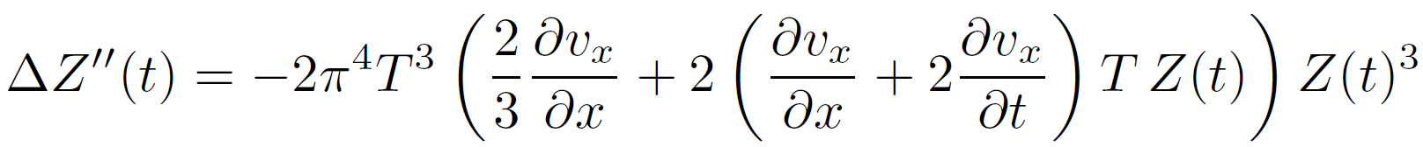
Second effect: Flow
Wilke van der Schee, MIT/Utrecht
Final formula for geodesics in ideal hydrodynamics:
(Z’’ essential for energy loss, but not proportional to energy loss)
Corrections due to viscosity:
Notes:
Many states + linearized

Slide 14
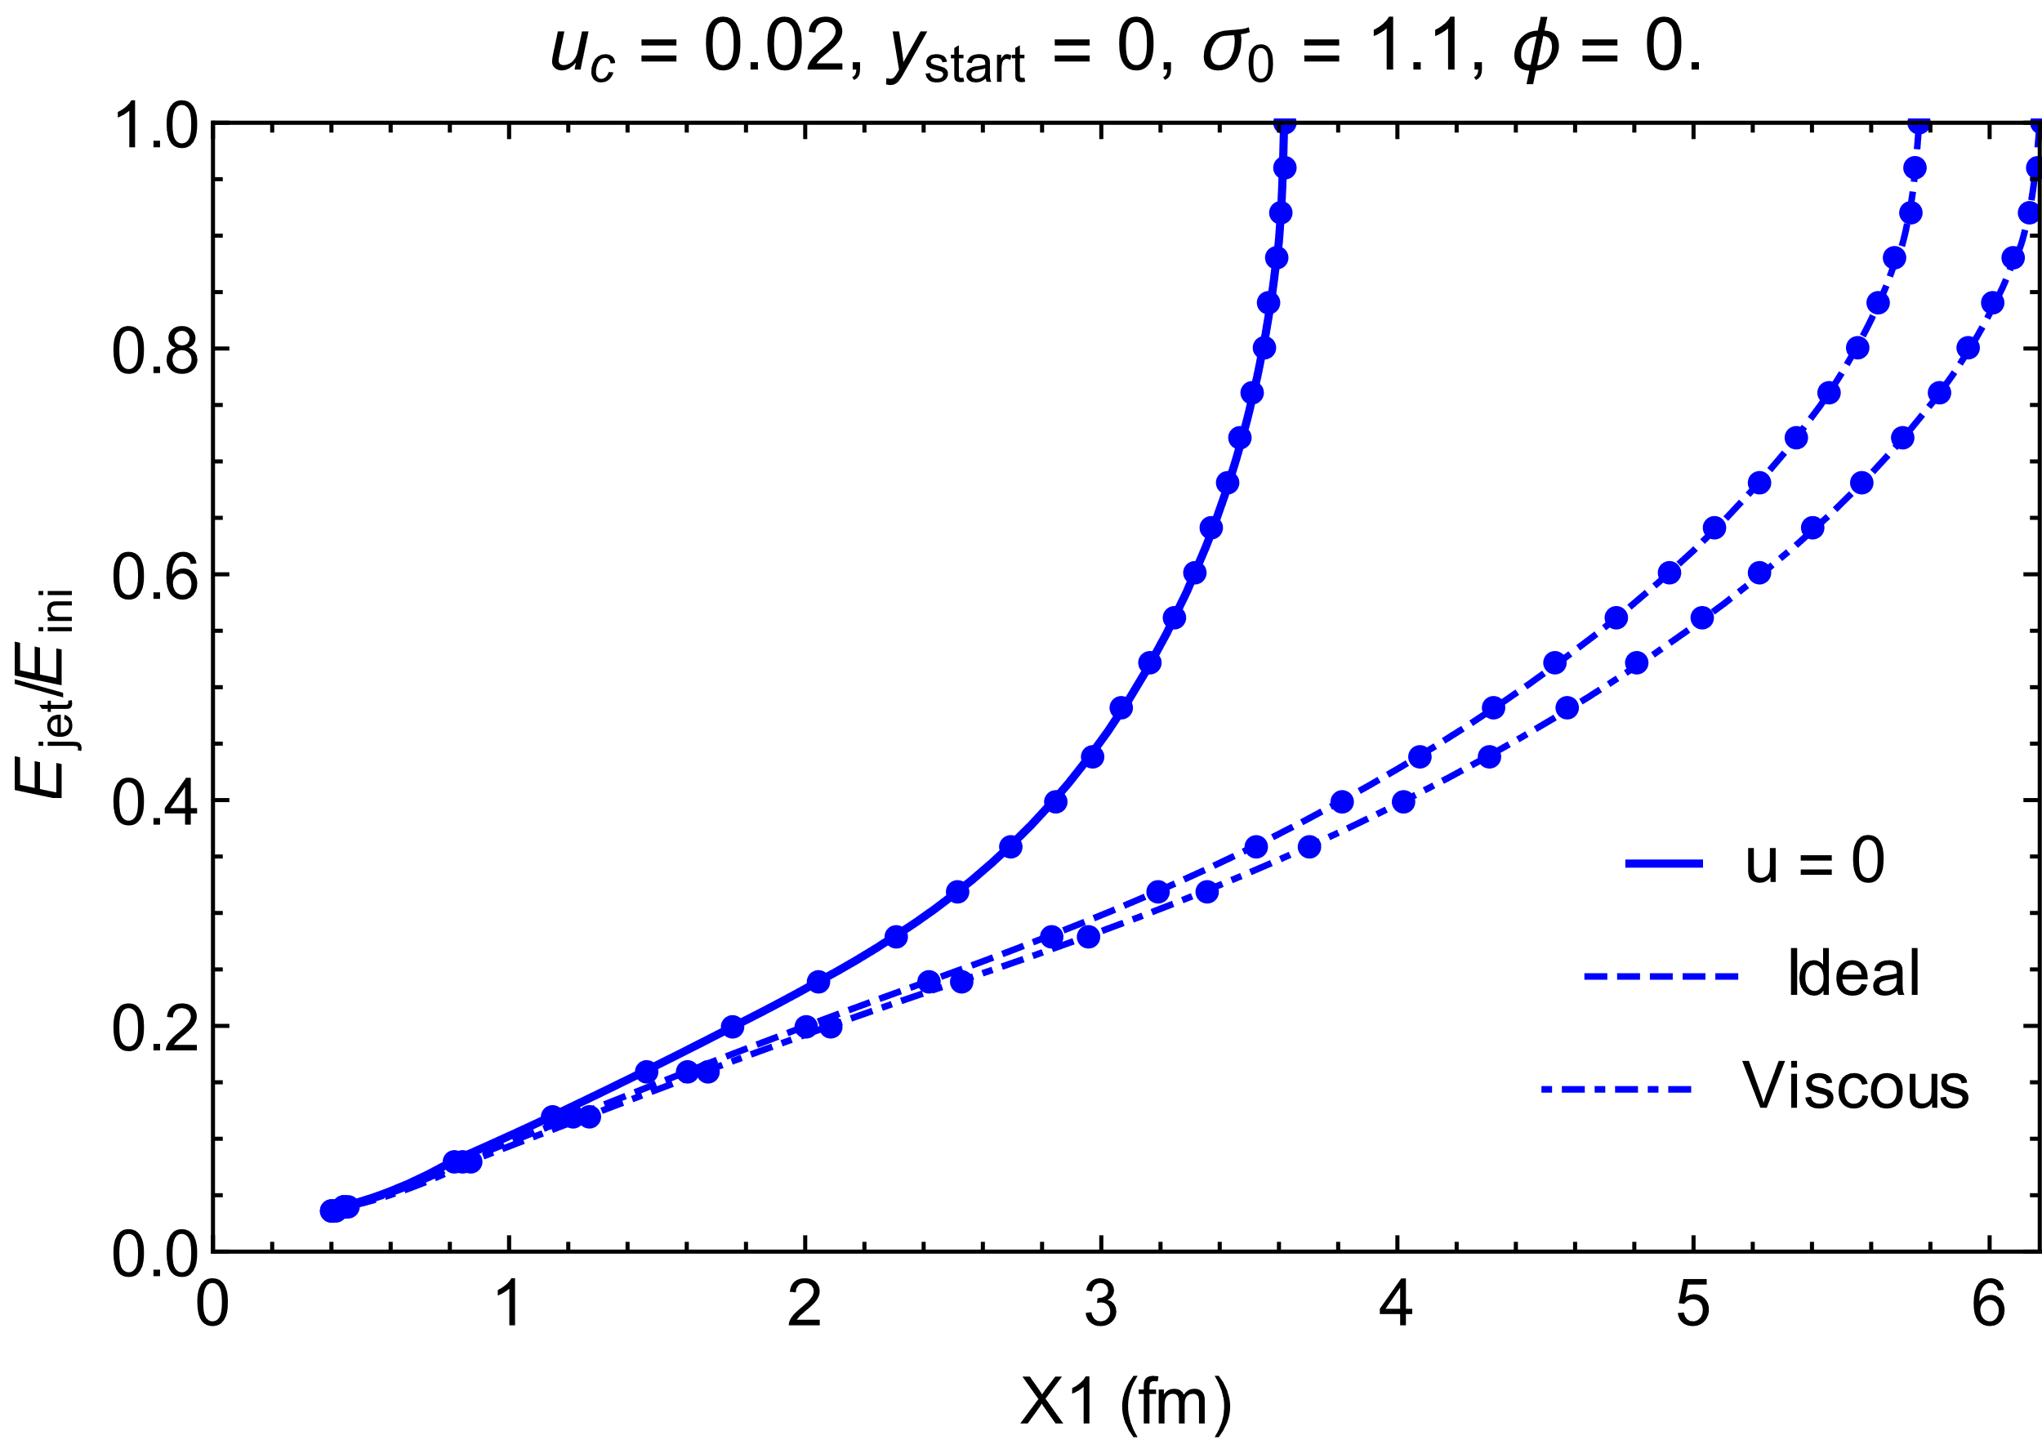
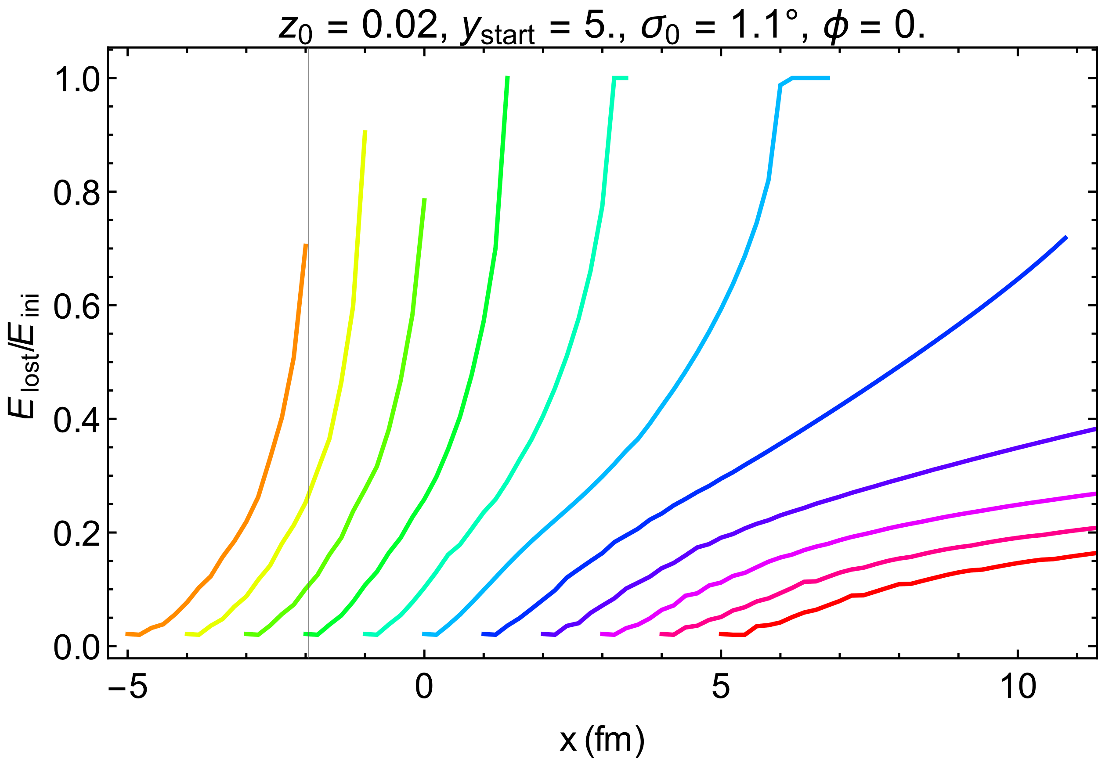
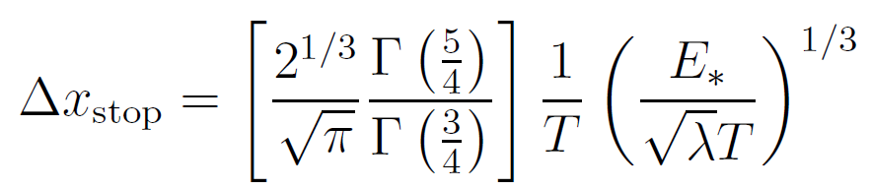
Results in Gubser flow
Wilke van der Schee, MIT/Utrecht
Resulting energy loss in (analytic) simple model for central collision
Compare no flow, ideal and viscous different starting points
  Flow has extremely important effect, doubling stopping distance
    Recall old result:
  Corrections due to gradients significant, but small
P.M. Chesler, K. Jensen, A. Karch and L.G. Yaffe, Light quark energy loss in strongly-coupled N = 4 supersymmetric Yang-Mills plasma (2008)
Andrej Ficnar and Steven Gubser, Finite momentum at string endpoints (2013)
Notes:
Many states + linearized

Slide 15
A simple algorithm
Wilke van der Schee, MIT/Utrecht
Energy loss from AdS/CFT in a dynamic setting
  Start with several string segments at boundary (~20), with different Z’
    Z’ of endpoint is determined by pQCD opening angle of q/g
    Z’ of other segments is taken from semi-universal curve (slide 6)
  Evolve Z(t) according to simple differential equation
  Straightforward to determine energy outside horizon
Main difference with current dE/dx approaches:
  Need to keep track of ~20 variables per parton,
  i.e. parton wave function more complicated than just energy
  2nd order equation: memory effect
    Perhaps similar to L² or L³ scaling of current approaches
  Relatively non-linear interplay of E(x) versus T(t) and v(t)
Notes:
Many states + linearized

Slide 16
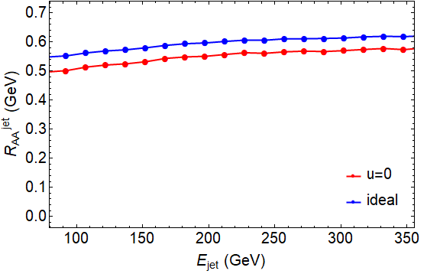
R^{jet}_{AA} coming from new formula
Wilke van der Schee, MIT/Utrecht
Result on nuclear modification factor
  Overall scaling somewhat arbitrary, determined by free parameter
  Effect of including flow significant, viscous contribution smaller
  Result quite similar to hybrid model, but different physics input: dynamic temperature + varying string initial conditions from pQCD
Notes:
Many states + linearized

Slide 17
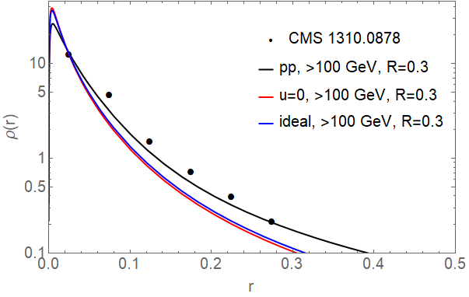
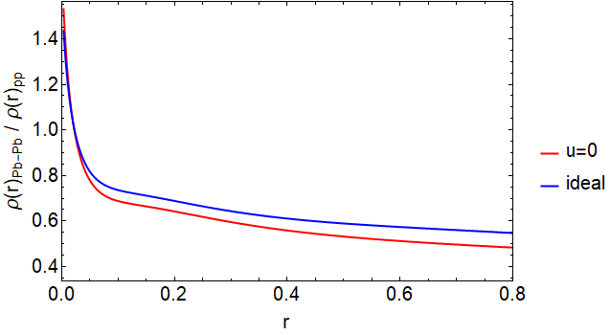
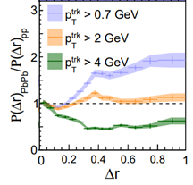
Modified jet shapes
Wilke van der Schee, MIT/Utrecht
Jet shapes have interesting interplay:
  Jets can get wider due to black hole
  Selection effect: narrower jets more likely to survive
  Now new effect: similar but smaller with jets in flow
Notes:
Many states + linearized

Slide 18
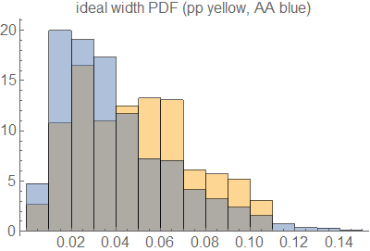
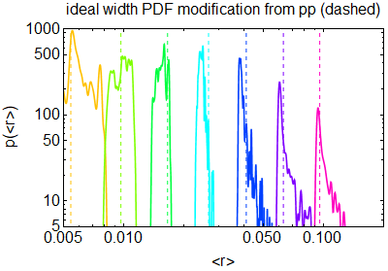
Modified Jet width distributions
Wilke van der Schee, MIT/Utrecht
Jet shapes become narrower: jet width distribution
  Can also compare with original pp ‘truth’ jet width
  Even individual jets can become narrower
    Only for intermediate widths and intermediate energy losses

Slide 19

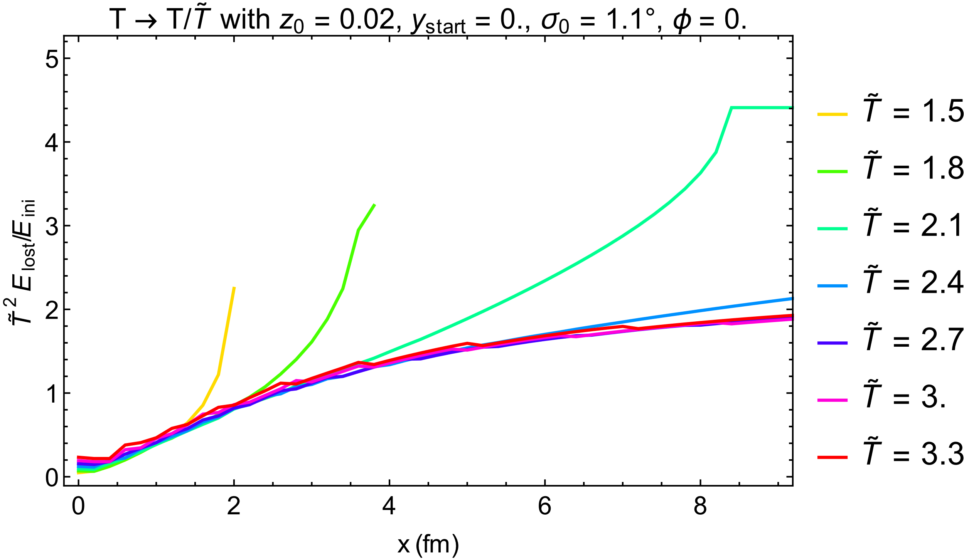
Energy loss versus temperature
Wilke van der Schee, MIT/Utrecht
Are there semi-general lessons for this energy loss?
  Try extracting dependence dE/dx on temperature: rescale T by
  Numerical finding: different curves collapse when scaling by T²
    Up to point where particular jet loses all energy: early time scaling
  (fairly robust, but scaling somewhat dependent on semi-universal curve, e.g. result from different black line gives T³)
Notes:
Many states + linearized

Slide 20
Discussion
Wilke van der Schee, MIT/Utrecht
Strong versus weak coupling
  Strings provide well-defined first-principle computation at strong coupling
    Interaction with medium may well be strongly coupled
  Limitations are clear: q/g production is described by pQCD
    Can give us insights into initial conditions of strings, i.e. energy + opening angle/jet width
    Holography misses hard splittings: all radiation is soft, no 3rd jets
    Likewise extra care is needed for jet radius (R) dependence of results
  A combination likely possible: treat all hard splittings (>10 GeV?) in pQCD, then switch to strings
Provided a simple algorithm for energy loss in a dynamic flowing medium
  Relatively straightforward implementation in e.g. Monte Carlos
  Interesting illustration of memory-effect: temperature evolution matters
  Very strong effects of flow, mild effects of gradient corrections (modulo subtlety)
  Interesting scaling dE/dx ~ T² in specific (realistic) model?
Outlook
  Implementation in Monte Carlo?
  Full understanding initial string condition still somewhat unsatisfactory: 3-jets etc
  Not quite related: back-reaction lost energy on medium: where does E/p go?
Notes:
Many states + linearized

Slide 21
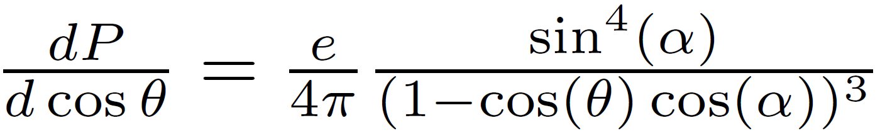
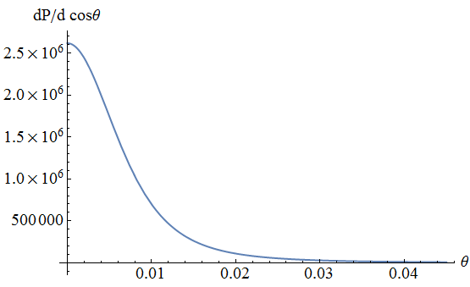
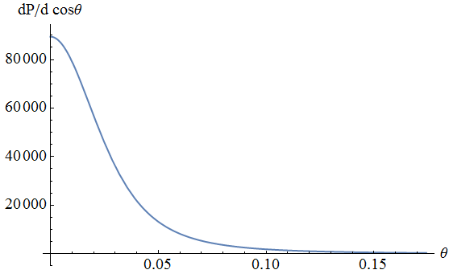
Jet angular spectrum
Wilke van der Schee, MIT/Utrecht
At late times string falls into AdS, straight lines for each σ.
  Stress-energy on boundary due to `collection of AdS point particles’:
  energy e,
  angle to center θ,
  AdS angle α
Left:
876 GeV (7% loss)
angle ~ 0.01
Right:
462 GeV (52% loss)
angle ~ 0.04
Y. Hatta, E. Iancu, A. Mueller and D. Triantafyllopoulos, Aspects of the UV/IR correspondence: energy broadening and string fluctuations (2010)
Notes:
Many states + linearized

