Slide 1
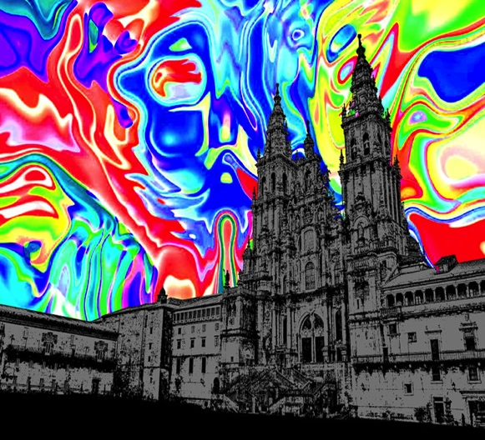
Non-zero chemical effects in
holographic RG flow
Irina Aref'eva
Steklov Mathematical Institute, RAS
Holography and Extreme Chromodynamics
2-5 July 2018 Santiago de Compostela, Spain

Slide 2
Outlook
HRG for one phenomenological model
Motivations for the model
Physical properties of the model
Exact HRG for two exp dilaton potential
Zero chemical potential
What is special for non-zero chemical potentia
What is special for anizotropic case
Based on:
I.A., K.Rannu, 1802.05652; I.A, A.Golubtsova, G.Policastro, 1803.06764

Slide 3
Starting point - 5-dim background

Slide 4

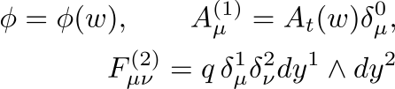
5-dim Background
Einstein-dilaton-two-Maxwell
I.A., K. Rannu, JHEP’ 18
Compare with anisotropic model Einstein-Axion-Dilaton action:
Mateos, Trancanelli,
1105.3472
Giataganas, Gursoy,
Pedraza, 1708.05691

Slide 5
Motivation: Multiplicity
Plot from PRL’16
(ALICE).
IA, Golubtsova
JHEP’15
Notes:
Gubser, Pufu, Yarom

Slide 6
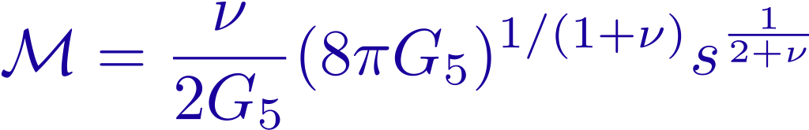
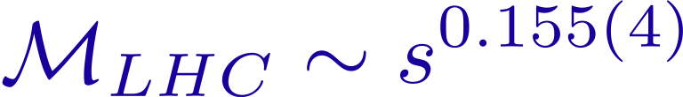

5-dim Background: Multiplicity and R-factor in the metric
IA, Golubtsova, JHEP’15
Shock domain walls collision: ENTROPY
To get

Slide 7

QCD Phase Diagram

Slide 8
“Phenomenological=no E.O.M.” O. Andreev, V.I. Zakharov, 0604204
Gubser et all, 0804.0434
Gursoy, Kiritsis, Mazzanti, Nitti (IHQCD), 0812.0792.
“Reconstruction of potential” White, 0701157; Pirner, Galow, 0903.2701;
He, Wu, Yang, Yuan, 1301.0385
Isotropic: M.-W. Li, Y. Yang , 1703.09184 +Refs therein

Slide 9
Blackening function g(z)

Slide 10
Blackening function g(z)

Slide 12
Scalar Field
C<0
c>0 instability regions
C=0
phicn2

Slide 13
Scalar potential

Slide 14
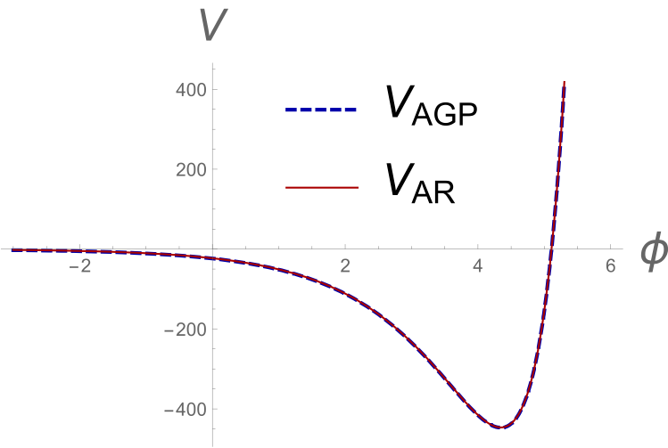
Scalar potential (two exp approximation)

Slide 15
Smeared confinement/deconfinement
phase transition (crossover transition)
in holography for the anizotropic model

Slide 16
Temporal Wilson loops
Energy between quarks located along x-direction
Holography for a probe
The recipe by Maldacena (‘98), Rey et al (‘98),
Sonnenschein et al (’98)
2-dim Born-Infeld dynamical system
Countour approach in YM in 80’
Effective actions
depend on orientation

Slide 17
Holographic anisotropic QCD phase diagram
From IA, K.Rannu, JHEP’18
Smeared confinement/deconfinement phase transition

Slide 18
The dependence of temperature T(zh,mu,c,nu) on zh
for c = - 1 and different mu for anisotropic, nu = 4.5 case

Slide 19
The comparison of dependences of temperature T(zh,mu,c,nu) on zh for c = - 1 and different mu for isotropic and anisotropic cases;
the horizontal orange and red lines show
locations of the global minima in isotropic and anisotropic cases

Slide 20
The phase diagrams in the (T,mu)-plane for the isotropic
background (green line) and for anisotropic nu = 4.5 background
(blue line).
LIBH and SIBH (LABH and SABH) indicate the regions
of small and large isotropic (anisotropic) black holes

Slide 21
Holographic anisotropic QCD phase diagram
From IA, K.Rannu, JHEP’18
Smeared confinement/deconfinement phase transition

Slide 22
Spatial Wilson loops
Ageev, IA, Golubtsova, Gourgoulhon, NPB’18

Slide 23
Spatial Wilson loops /Drag Forces/Diffusion coefficients
Drag forces
Gubser, 0605182

Slide 24
Spatial tension in equilibrium
solid - Xy plane
dashed – xY plane,
dotted y₁Y₂ plane.

Slide 25
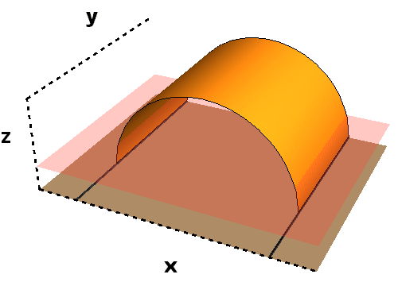
String in thermalizing media
The spatial tension during thermalization
Similar to Vaidya-AdS
Danielsson, Keski-Vakkuri, Kruczenski, 9905227;
Abajo-Arrastia, Aparicio, Lopez, 1006.4090;
Balasubramanian et all 1012.4753
Vaidya-Deformed-AdS

Slide 26
For zero mu
t=0.1, 0.5, 0.9, 1.4, 2 (from down to top)

Slide 27
Jet quenching
The jet-quenching parameter is related with the average of the light-like Wilson loop in the adjoint representation
Kovner, Wiedemann, hep/ph 0106240
H. Liu, K. Rajagopal and Wiedemann, PRL’06
C is a rectangular contour with large extension in a light-like
and small extension in a transversal one
For x-light-like (x₋=t-x) direction
D.A, IA, A.G., E.G, NPB’18
Notes:
One of the important characterizations of heavy-ions collisions is the jet quenching.

Slide 28
Direct photons and electric conductivity
The thermal-photon production from the QGP plays an essential role.
Photons after they are produced in HIC almost do not interact with the QGP.
Photons give us the local information on heavy ion collisions.
The photon-emission rate is related to the retarded correlator of currents in momentum space
S.I.Finazzo and R.Rougemont, PRD’16
I.Iatrakis, E.Kiritsis, C.Shen and D.L.Yang,
arXiv:1609.07208

Slide 30
Electric conductivity
Iso
Aniz
Iso
Aniz
Increasing the anisotropy we
increase the EC at T>T_{cr} ,
and via versa for at T<T_{cr}
IA, arXiv:1612.08928

Slide 31
Conclusion for the 1-st part:
Holographic models are some kind of phenomenological models
with few number of parameters
We have considered the anizotropic model that describes:
multiplicity, quark confinement;
predicts:
crossover transition line between confinement/deconfinement phases
anizotropy in hadron spectrum (for a short time after collisions)
Anisotropy drastically change standard holographic calculations, in particular,
Wilson loops, and quark potential
Jet quenching
Drag forces
shear viscosity and therefore elliptic flows
susceptibility
thermalization time

Slide 32

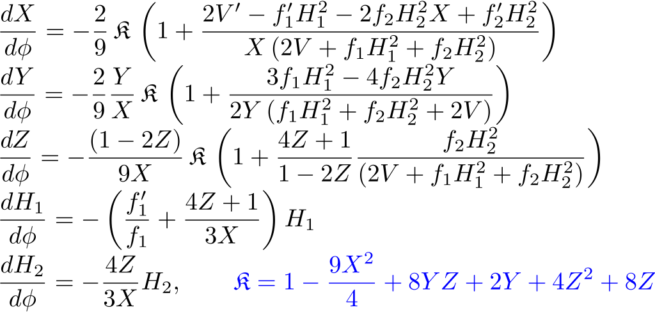
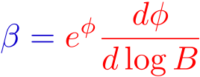
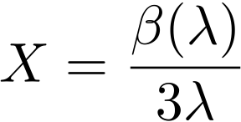

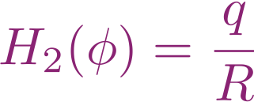
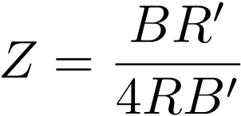
Holographic Anizotropic RenormGroup Flow
Non-zero
temperature
Non-zero Aniz. :
Non-zero
chemical potential
Einstein-Dilaton-two-Maxwell E.O.M. are equivalent to AnizRenormGroup eqs:
I.A.,K.Rannu
In preparation

Slide 33

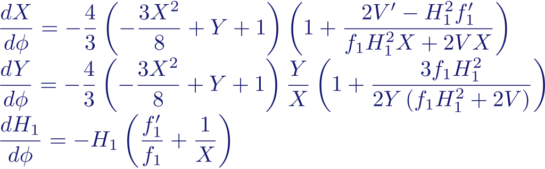
Holographic Isotropic RenormGroup Flow
Non-zero chemical potential
Non-zero temperature
Suitable for NICA
Einstein-Dilaton-one-Maxwell E.O.M. are equivalent to Isotropic RenormGroup eqs:
I.A., K.Rannu, JHEP’18

Slide 34

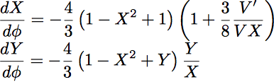
Holographic Isotropic zero RG Flow
Zero chemical potential
Non-zero temperature
Einstein-Dilaton E.O.M. are equivalent to HRG eqs:
Gursoy, Kiritsis, Mazzanti,
Nitti, arXiv:0812.0792

Slide 35



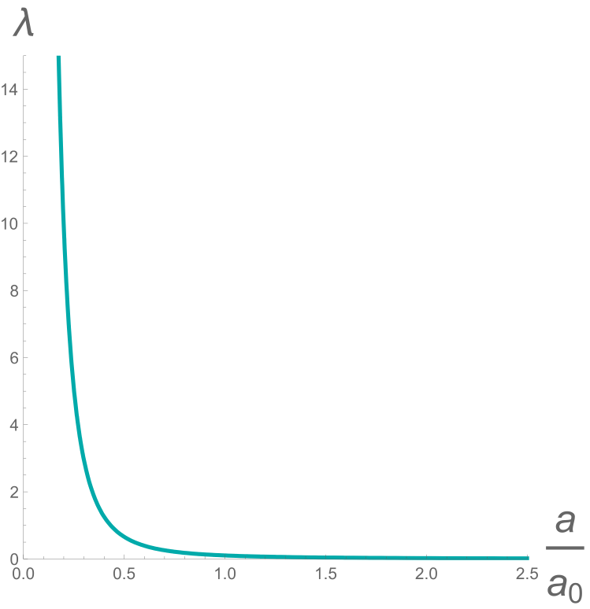
Holographic RenormGroup Flow
Einstein-Dilaton-E.O.M. are equivalent to HRG eq:
IR Quark confinement + UV Asymptotic freedom
Improved HQCD,
Big activity 08-14

Slide 36
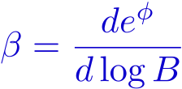

Holographic RenormGroup Flow, T=0
Cosmological const + free dilaton
Explicit solutions

Slide 37
Holographic Renormgroup Flow, T=0
Chamblin-Reall-model, 99
Exp-potential

Slide 38
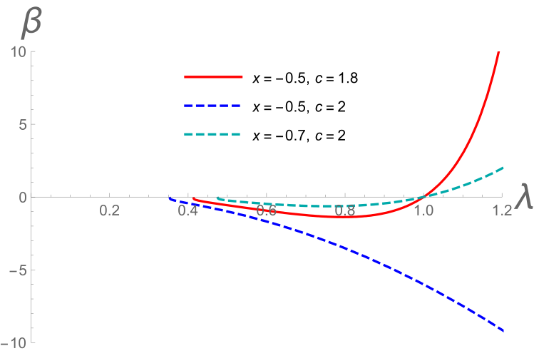
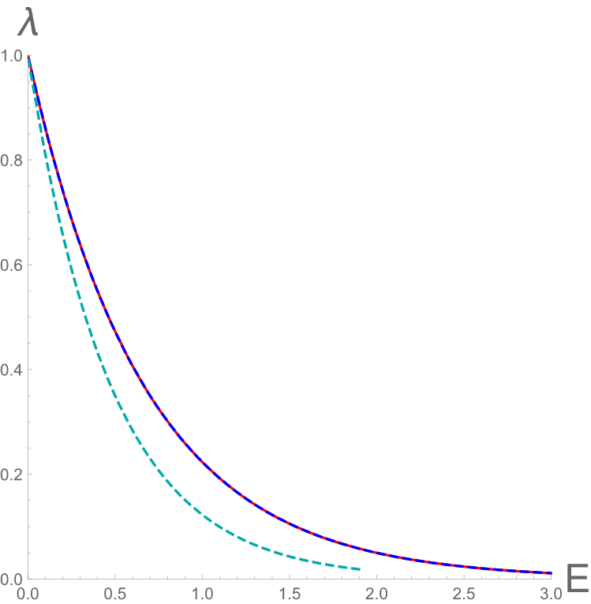
Holographic Renormgroup Flow, T=0
Beta-function in Chamblin-Reall-model

Slide 39
Holographic RG Flow, T=0, mu nonzero
Generalized Chamblin-Reall-model:
Compare with Charmousis
et al, 1005.4690
X
H

Slide 40
Two Exp-potential provides an essentially more rich structure
I.A., A.Golubtsova and G. Policastro,
«Exact holographic RG flows and the A₁х A₁ Toda chain»,
arXiv: 1803.06764
Two motivations:
1) Relation with realistic models
2) Explicit solution, relation with group theory and possible
generalizations

Slide 41
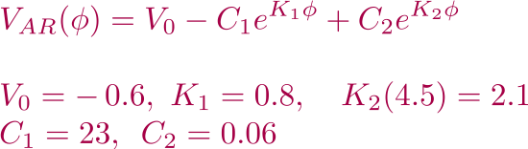

Holographic RenormGroup Flow, T=0
I.A.,Golubtsova, Policastro,arXiv: 1803.06764
I.A., Rannu, arXiv: 1802.05652

Slide 42
Holographic RG Flow
Generalization of Chamblin&Reall model, hep/th9903225

Slide 43
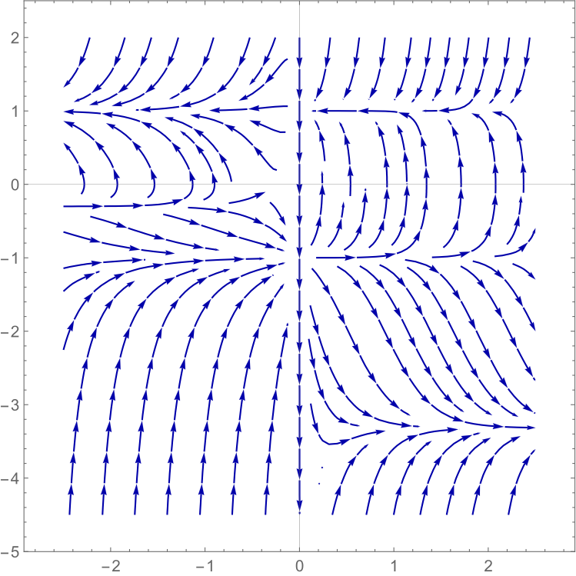
New attractors
k=0.4, C₁= 2= -C ₂

Slide 44

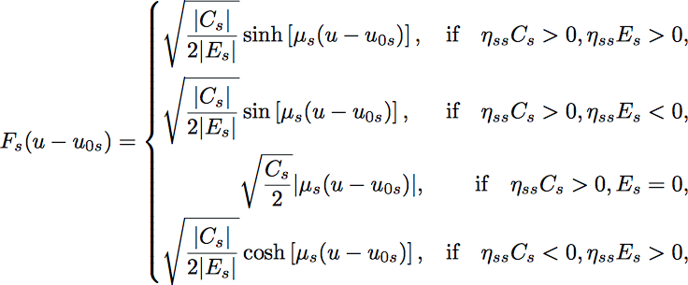

The solution for the metric and the dilaton
Explicit answer due to integration of the mechanical model (A1хA1 Toda model)

Slide 45

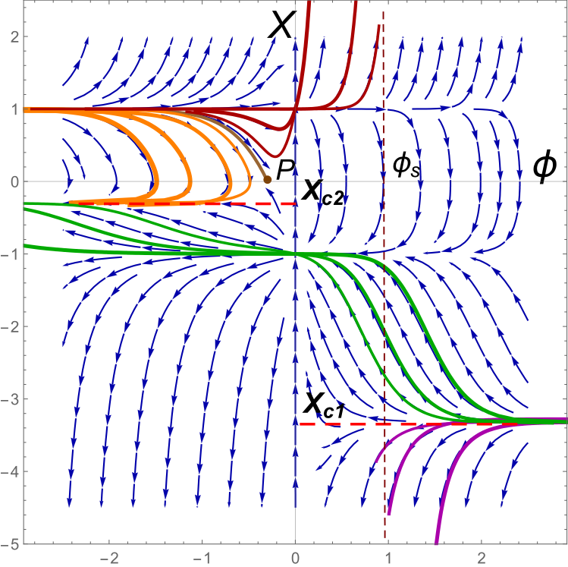

Slide 46

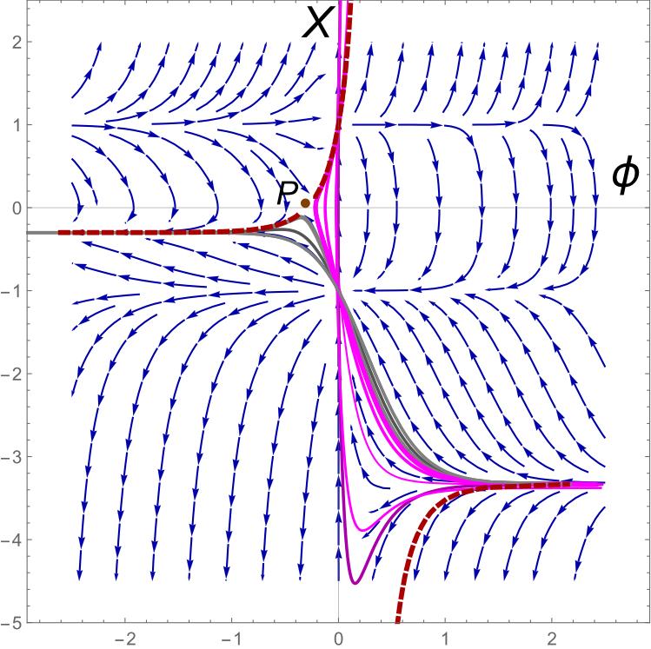

Slide 47

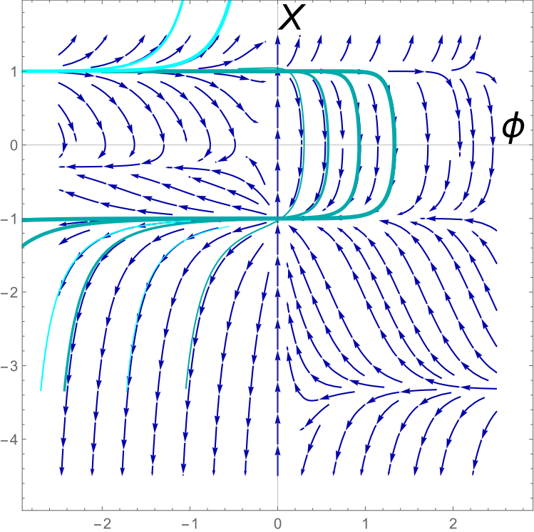

Slide 48
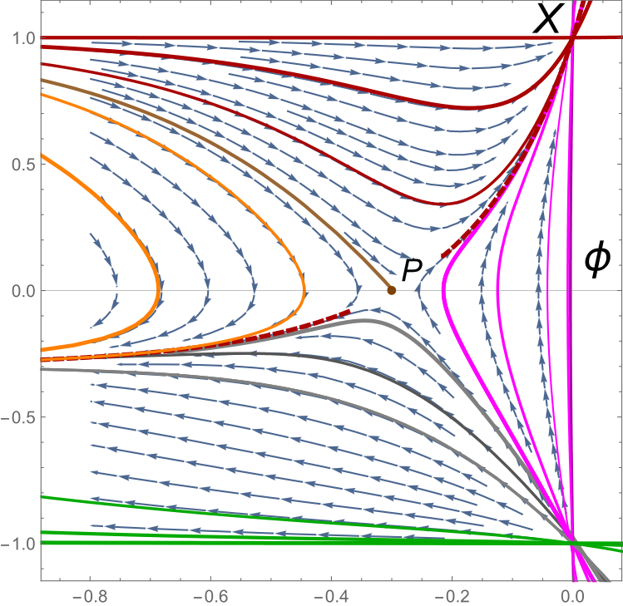

Slide 49
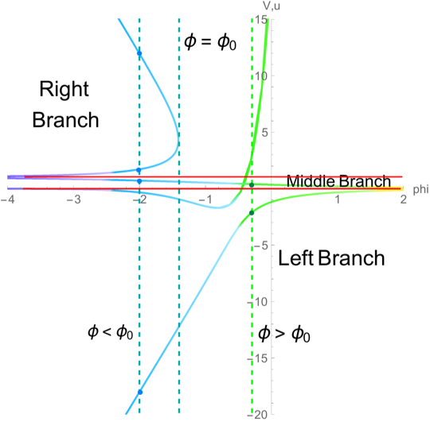
Vacuum solutions for the dilaton - 3 regions!

Slide 50
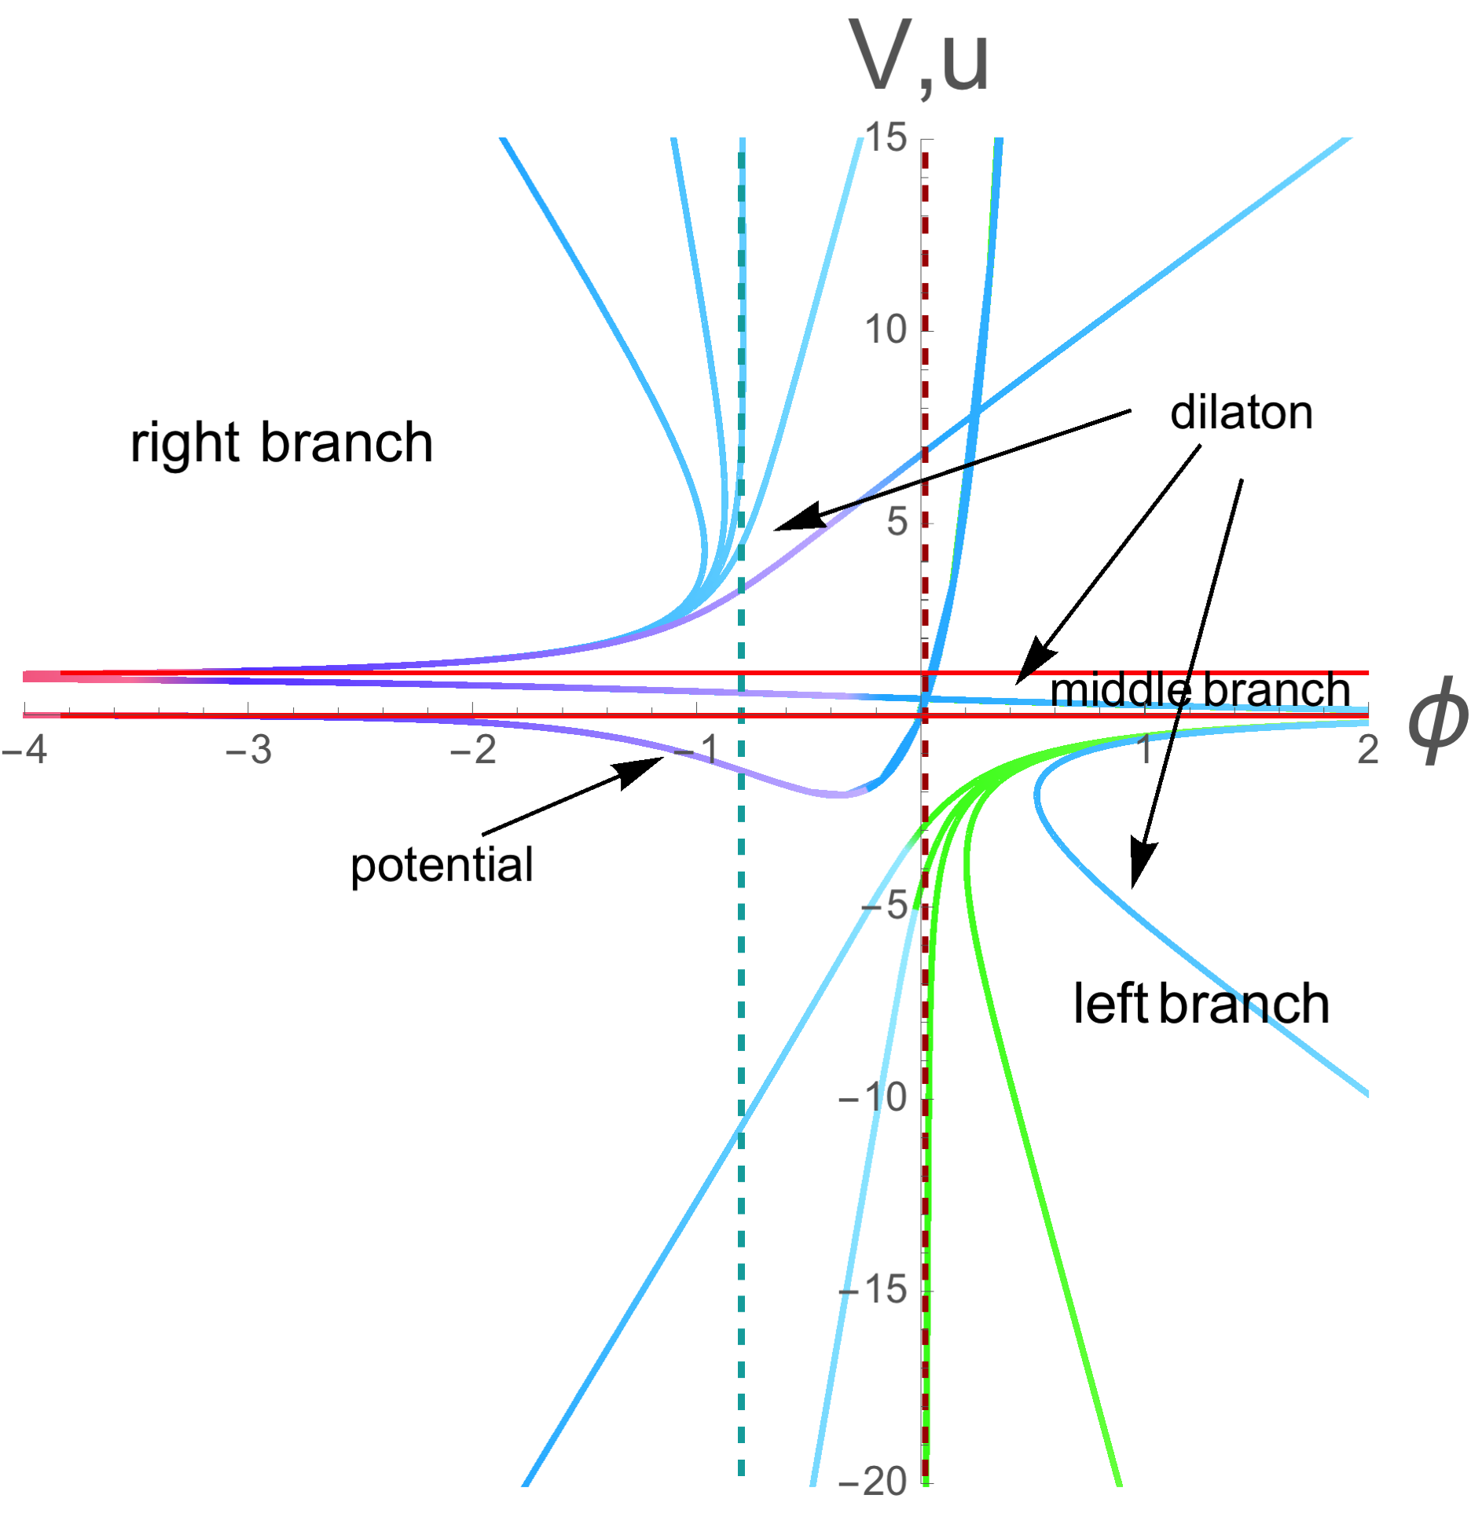
Black Brane solutions

Slide 51

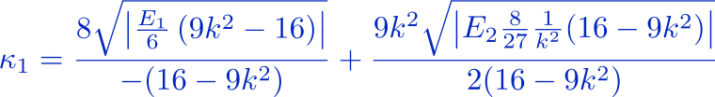


Black Brane solutions
Removing conical singularities
There is no conic singularity if

Slide 52
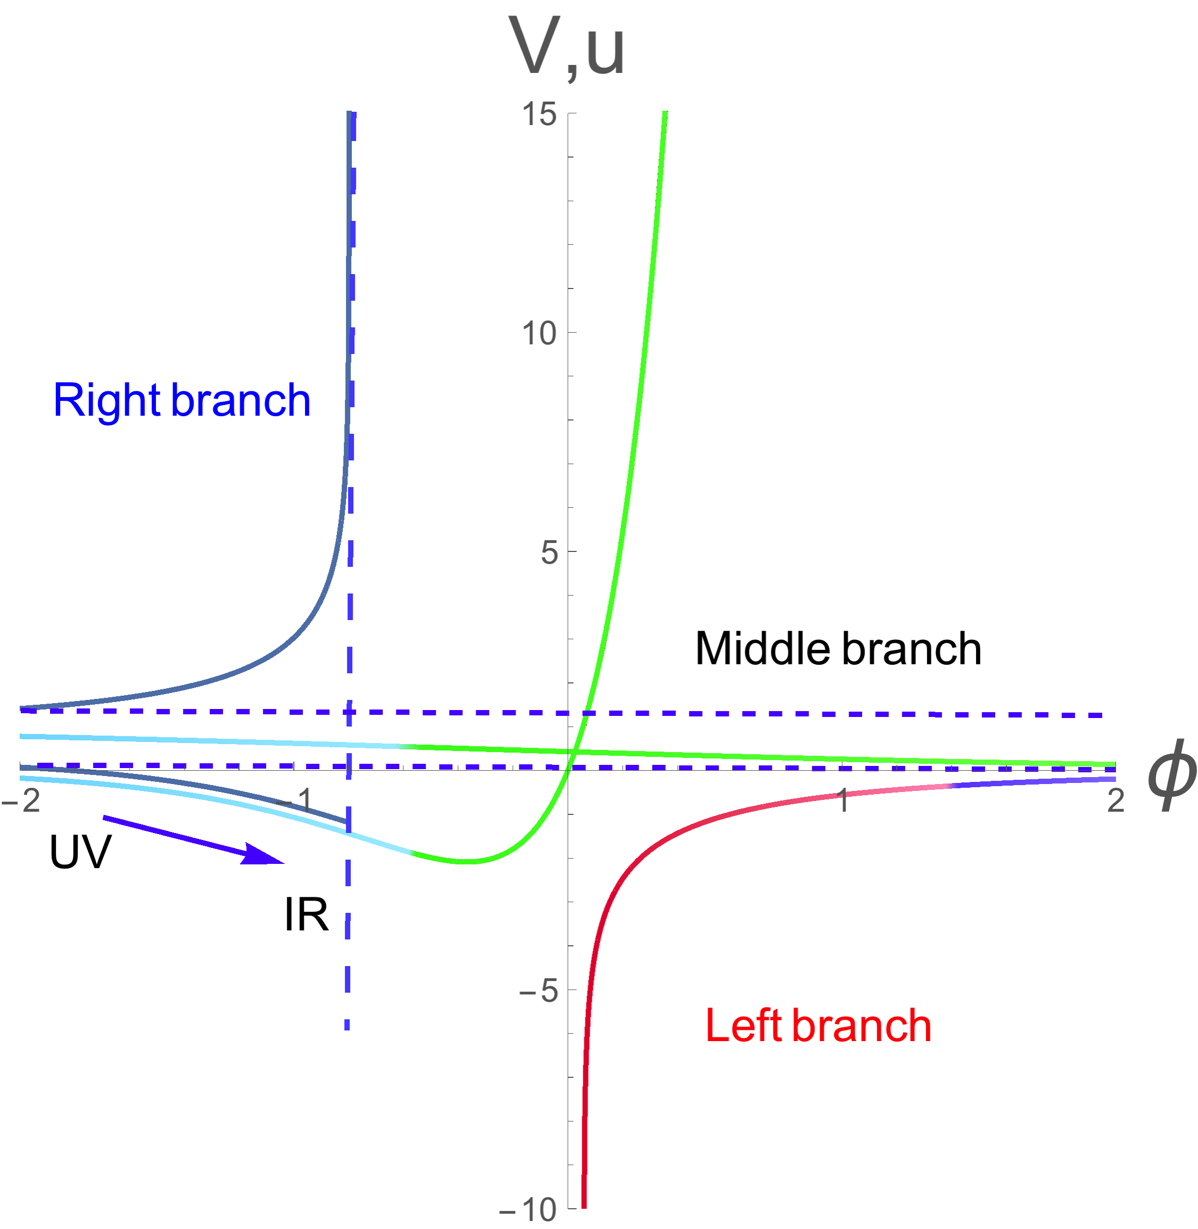
Black Brane solutions without singularities
Gubser's criterion
is realized on the right
branch

Slide 53
Summary for the 2-nd part
HRGeqs are derived for non-zero chemical potential and anisotropic backgrounds
Exact HRGflow for 2 exp potential is studied (mu=0)
We expect: exact HRGflow for 2 exp potential and non-zero chemical potential that would describe confinement/deconfinement phase transition

Slide 54
Summary
We have started from the simple phenomenological 5-dim metric and realized it as the solution.
Take more realistic metric to get the Cornel potential
(in isotropic-limit)
We have found crossover (smeared) transition line between confinement/deconfinement phases and dependence of physical quantities on orientation
We expect anisotropy in hadron spectrum (for a short time after collisions)
We have found the exact RG flow for dilaton potential closed to phenomenological acceptable
We hope to find exact RG flow for non-zero chemical potential
and may be for suitable anizotropy
Multiplicity estimations at non-zero chemical potential

Slide 55
Thank you very much!

