Slide 1
Holographic Floquet states ~Oscillatory Electric Field in Holography~
Osaka University
Keiju Murata
with S. Kinoshita, T.Oka
"Holographic Floquet states II: Floquet condensation of vector mesons in nonequilibrium phase diagram"arXiv:1712.06786

Slide 2
Introduction

Slide 3
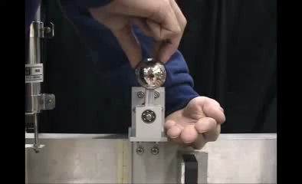
Floquet = Time periodic
Floquet state
= Stationary non-equilibrium state in
periodic driving
Classical example: Kapitza’s inverted pendulum
Taken from Youtube
vibrating base
frequency:
Periodic external driving can induce new stable states.

Slide 4
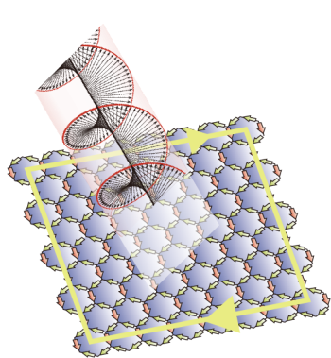
Importance of Floquet states in condensed matter
Creating materials on demand by laser.
Example:
Floquet topological insulator
Oka&Aoki, 09
Graphen
Enhancement of superconductor
Kaiser et al, 14, Hu et al 14, Mitrano et al 16
Superconductor
even at a room temperature?

Slide 5
Theoretical difficulty in Floquet states
Floquet states:
Time dependent + Quantum many body system
Non-equilibrium.
What is density matrix?
Physical quantities such as electric current?
We use AdS/CFT to study the Floquet Physics.

Slide 6
Holographic Floquet
Hashimoto, Kinoshita, KM, Oka, 16
Dirac semimetal
Weyl semimetal
Rotating
Electric field
Kimura et al, 17
AC conductivity
Linear + hump
AdS/CFT
Linear + hump
Consistent with experiment.

Slide 7
Related works
Global AdS
+ external periodic scalar source.
Biasi, Carracedo, Mas, Musso and Serantes, 18
Holographic superconductor
+ external periodic electric field.
Ishii’s talk
on wed.
Li, Tian and Zhan, 13
Natsuume and Okamura, 13
Ishii and KM, 18

Slide 8
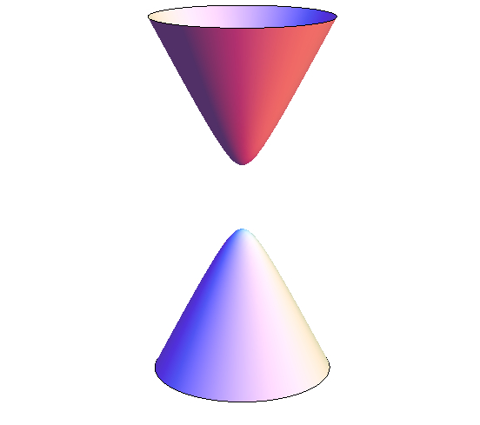
Purpose of this work
We study
Floquet states of gapped (3+1)D Dirac insulator
using AdS/CFT.
Band structure is nearly parabolic.
Dirac
insulator
circularly
polarized
laser
Phase structure?
New phase?
Physical quantities?
(e.g.Bismuth or Bi2Se3)

Slide 9
Setup

Slide 10
Simplest model for
Dirac insulator
Karch&Katz, 02
0 1 2 3 4 5 6 7 8 9
Nc D3 ✓ ✓ ✓ ✓
Nf D7 ✓ ✓ ✓ ✓ ✓ ✓ ✓ ✓
1,2,3
N=2 Super symmetric QCD
F-string
D3
D7
Strongly coupled Dirac fermions.
quark&antiquark ~ electron&hole
8,9
Use this as a model of
Dirac insulator.
4,5,6,7

Slide 11
Gravitational picture
1,2,3
near D3
D3
D7
D7
in AdS5 x S5.
8,9
4,5,6,7
D7 action
induced metric
Electromagnetic field
in AdS5 x S5
is AdS boundary

Slide 12
Applying rotating electric field
Asymptotic expansion of gauge field near the AdS boudary:
external
electromagnetic field
Its response:
electric current
Ansatz:
rotating electric field
Ingoing b.c.
effective
horizon
AdS boudary
D7-brane

Slide 13
Rotating electric field is “easier” than linearly polarized one.
Hashimoto, Kinoshita, KM, Oka, 16
Introduce a complex gauge field:
boundary condition:
Introduce a new field:
boundary condition:
time-independent b.c
The action does not depend on time, explicitly

Slide 14
Reduction to 1D problem
1. The action does not depend on time, explicitly
2. Time-independent boundary condition.
Consistently assume
1D Lagrangian along z-direction:
Linearly polarized case,
we need to address (1+1)D problem.

Slide 15
Phase structure

Slide 16
DC electric field case (Ω=0)
D3/D7 model calculation
D-brane profile
Current
Electric field
Insulator - Conductor transition at
Schwinger limit

Slide 17
Phase diagram is “lobe-shaped”.
D-brane profile
meson (exciton) spectrum
Kruczenski, Mateos, Myers, Winters, 03
The critical electric field becomes (almost) zero
near the meson spectrum.

Slide 18
Why critical E becomes small near exciton spectrum?
exciton = bound state of electron and hole
Exciton BEC
Yoshioka et al, 11
Fine-tuned
laser frequency
many excitons
BEC
Debye screening
by excitons
Electron and hole liberate
single electron
: electron
The number of carrier increases.
: hole
electric field is screened.

Slide 19
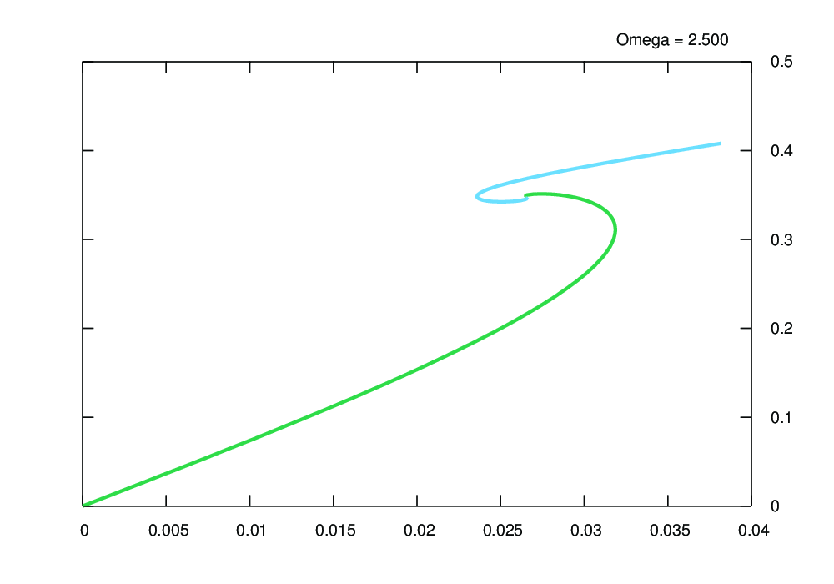
Electric current near critical frequency
Changing
conductive
insulator
green: insulator
light blue: conductive
E=0-but-J≠0 phase
J is multi-valued in a complicated way.

Slide 20
Microscopic picture of
E=0-but-J≠0 phase
In linear level,
normal modes of gauge field on D-brane
have been found in
Kruczenski, Mateos, Myers, Winters, 03
They are identified as vector mesons.
E=0-but-J≠0 phase is just a its nonliear extension.
Condensation of vector mesons?

Slide 21
Summary
Floquet states of (3+1)D gapped Dirac electrons
were studied using AdS/CFT.
Phase diagram is “lobe-shaped”.
Insulator-conductor transition
by weak electric field for a fine-tuned frequency.
Existence of E=0-but-J≠0 phase.
Vector meson condensation?
Experiment?
Stability of vector meson condensation?
Implication to QCD?
Future directions:

Slide 23
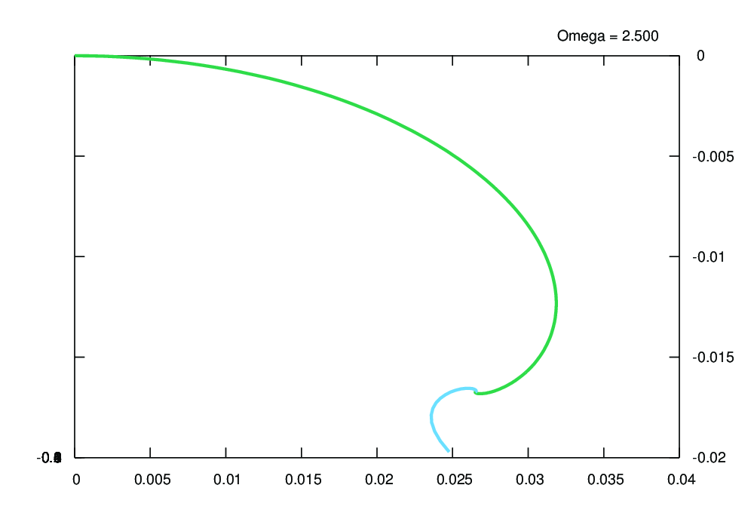
E vs c

Slide 24
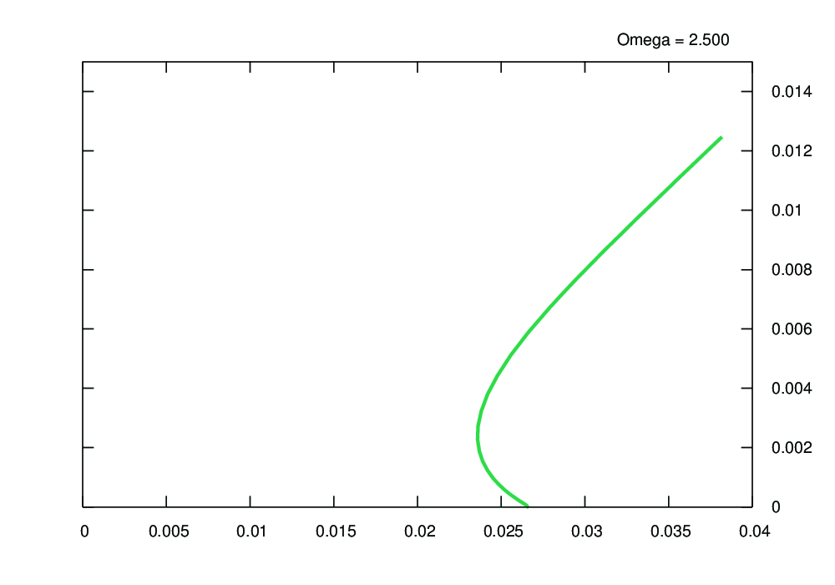
E vs q

