Slide 1
Using spectral methods to find the Quasi-Normal Modes (QNM) of electromagnetic branes
Numerical Relativity & Holography 2016
Santiago de Compostela, Spain
27th June 2016
Roshan Koirala
University of Alabama, Tuscaloosa, USA
Collaboration work with M. Ammon, M. Kaminski, J. Leiber, J. Wu

Slide 2
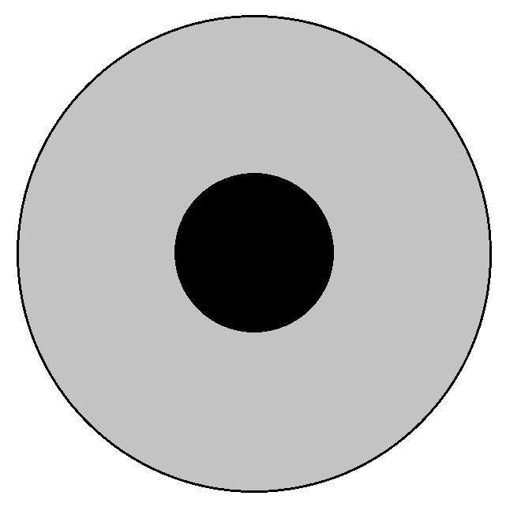
Holography applied to systems far from equilibrium
Strongly coupled Quantum Field Theory (QFT) in 4 dimensions is holographically dual to the weakly curved gravity theory in 5 dimensions.
Generalized Eddington Finkelstein coordinates
$(v,x_{1}$, $x_{2}$, $x_{3},z)$
Time dependence of the gravity background can be mapped to the far from equilibrium behavior within the field theory dual.
z $ε [0,1]$
Example: Heavy ion collision.
black hole
Holography identifies Quasi Normal Mode (QNM) frequencies with the poles of Green’s functions. For example
Conformal boundary of Anti de Sitter (AdS) space time at z=0

Slide 3
Holographic model for the charged Quark Gluon Plasma (QGP) in external magnetic field
Action
Dual to chiral anomaly
The resulting equations (L=1)
Metric and field strength tensor

Slide 4
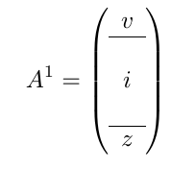
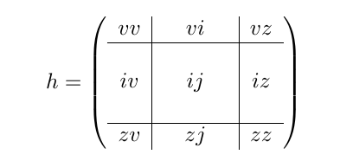
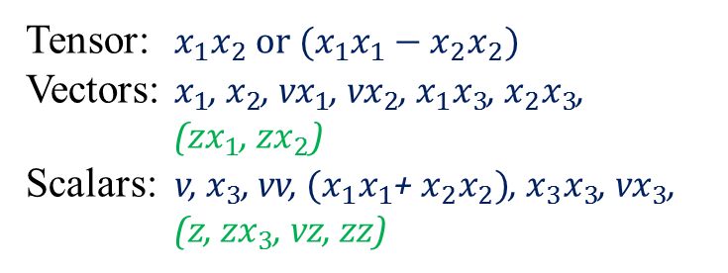
Fluctuation Equations
Fluctuations
Radial Gauge
Component classification under SO(2)
in $x_{1}x_{2}$ plane
Scalar-vector-tensor decomposition of
the metric and gauge fluctuations
Tensor: $x_{1}x_{2} or{ (x}_{1}x_{1}−x_{2}x_{2})$
Vectors: $x_{1}$, $x_{2}$, v$x_{1}$, v$x_{2}$, $x_{1}x_{3}$, $x_{2}x_{3}$,
(z$x_{1}$, z$x_{2}$)
Scalars: v, $x_{3}$, vv, ${(x}_{1}x_{1}$+ $x_{2}x_{2})$, $x_{3}x_{3}$, v$x_{3}$, (z, z$x_{3}$, vz, zz)
Coupled equations with constraints

Slide 5
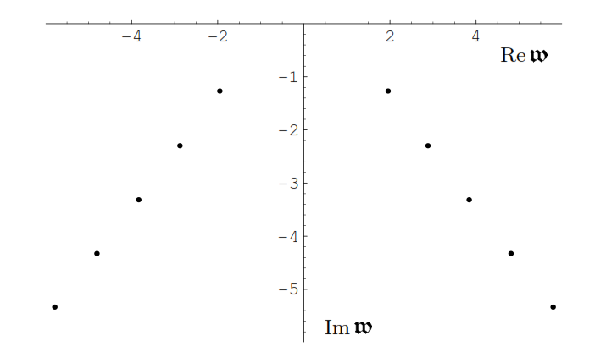
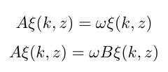
Quasi Normal Modes (QNM) in gravity dual
Fourier modes
QNM of Schwarzschild metric (spin two mode)
Eigenvalue problem and generalized eigenvalue problem
Vanishing Dirichlet boundary condition at the boundary z = 0
And incoming boundary condition at the horizon z = 1
Kovtum P.K. & Starinets A.O. (2005)
Non-Hermitian problem!!

Slide 6
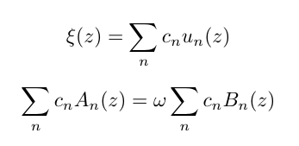
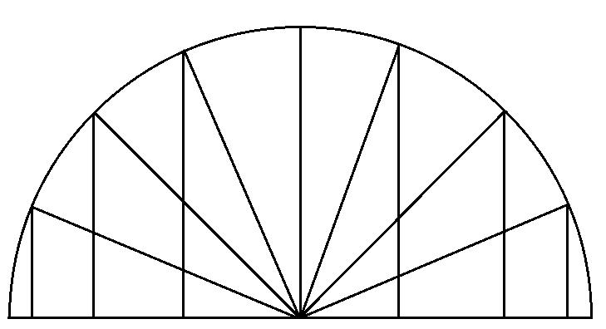
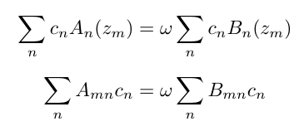
Spectral method overview
The generalized eigenvalue problem
Collocation points
Expanding in complete set
The matrix form
$z_{0}$ $z_{1}$ $z_{2}$ . . . . . . . . . . $z_{N−1}$ $z_{N}$

Slide 7
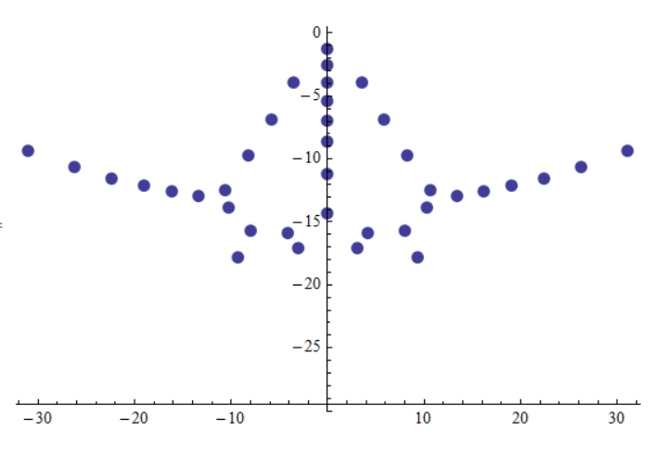
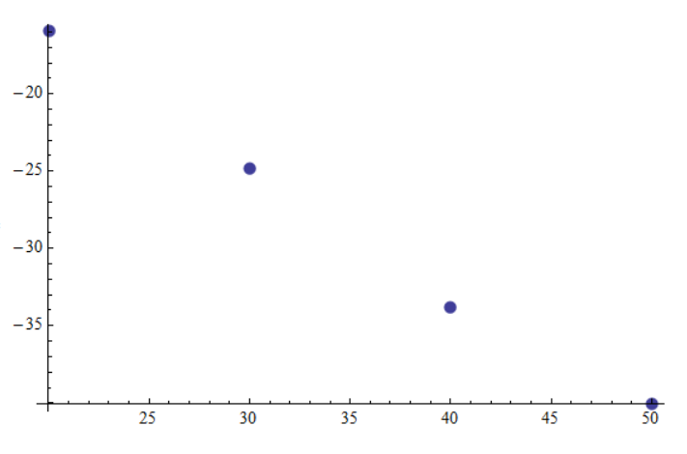
Using spectral method to solve spin two modes of electromagnetic brane
Plot of QNM result for B=0, k=0
Convergence of the QNMs
Im(𝜔)
$\lim_{n→∞}{|ξ\left(z\right)−}ξ_{n}$(z)| = 0
$$−1.2078048ⅈ$$
$log⁡|ξ_{max}\text{(}\text{z}\text{)}−ξ_{n}$(z)|
Re(𝜔)
n

Slide 8
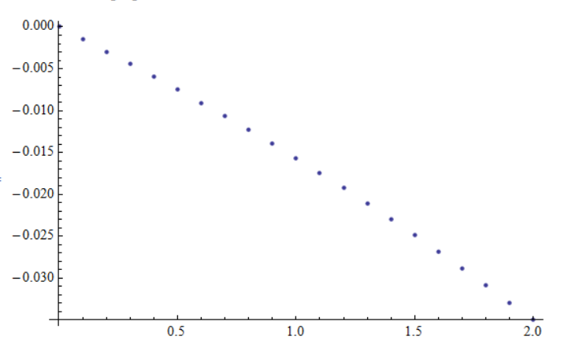
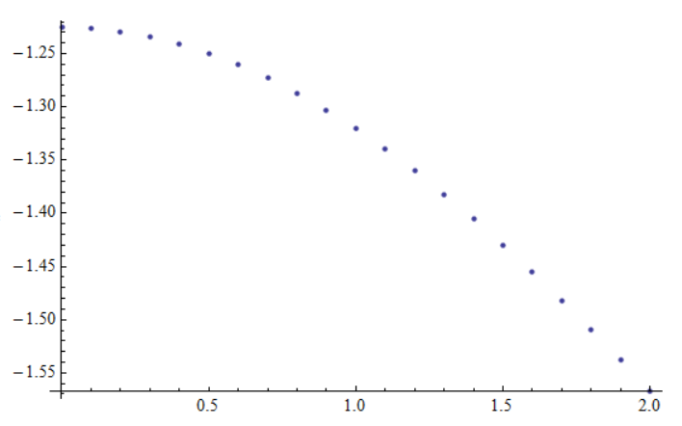
Dispersion relation of spin two mode
Run of lowest QNM of spin two mode for B = 1/10, µ = 1.8 for varying momentum.
Re[𝜔]
Im[𝜔]
k
k
Green’s function with gapped mode

Slide 9
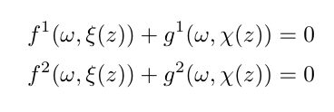
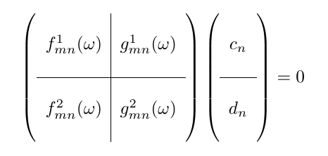
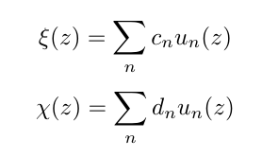
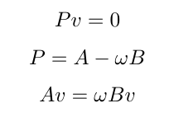
Spectral method for the coupled system
Coupled eigenvalue problem
The big matrix
Series expansion
Back to the generalized eigenvalue problem
Substituting
What if there are constraint
equations too?

Slide 10
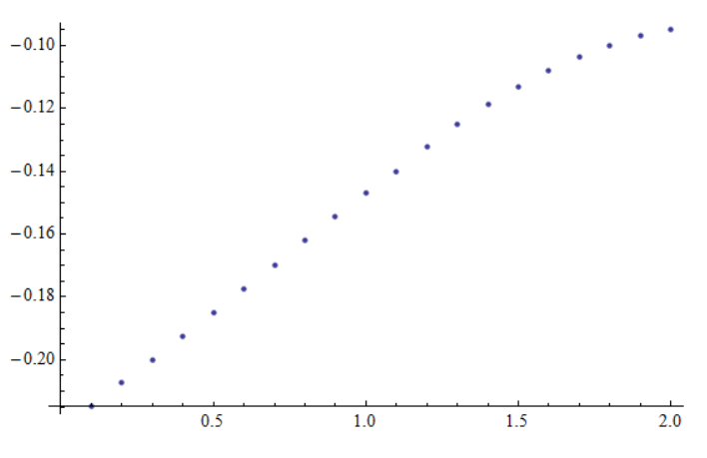
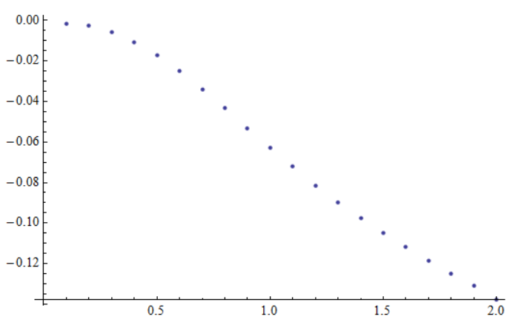
Dispersion relation of spin one mode
Run of lowest QNM of spin one mode for B = 1/10, µ = 1.8 for varying moment.
Re(𝜔)
Im(𝜔)
k
k
Green’s function with gapped mode
Compare to diffusion pole B=0

Slide 11
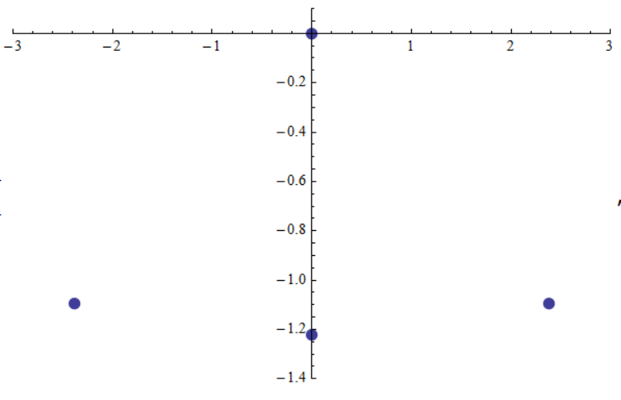
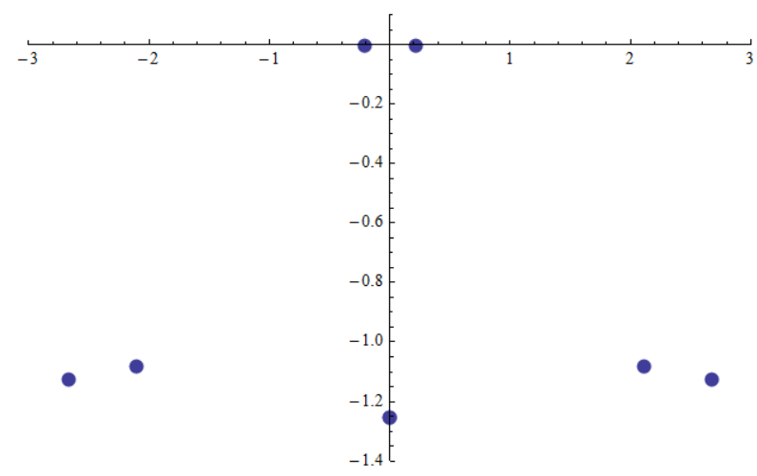
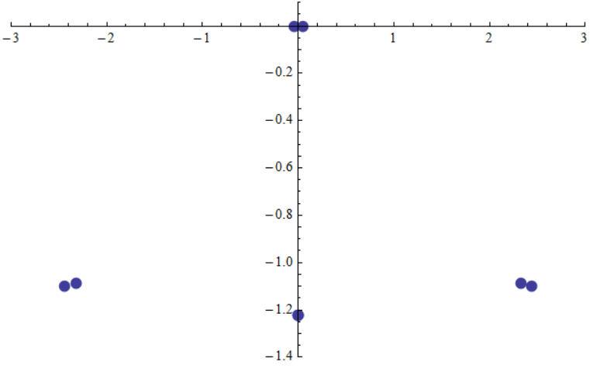
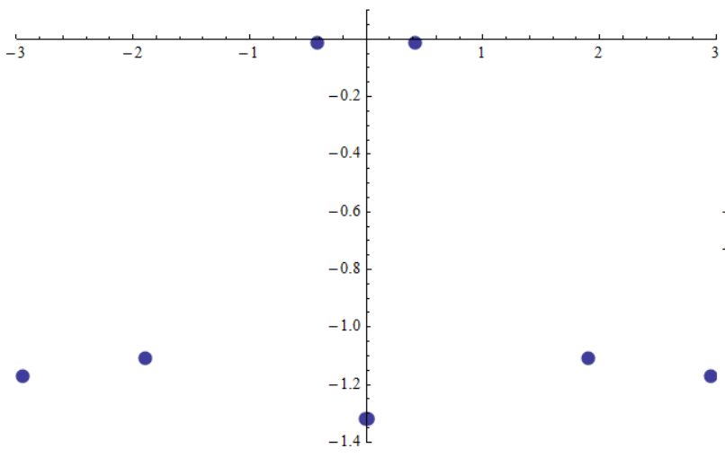
Lower QNMs as a function of B with constant chemical potential (µ=1.8) in spin one mode
Re(𝜔)
Re(𝜔)
B=0
B=1/2
Im(𝜔)
Im(𝜔)
Re(𝜔)
Re(𝜔)
B=1/10
B=1
Re(𝜔)
Im(𝜔)
Im(𝜔)

Slide 12
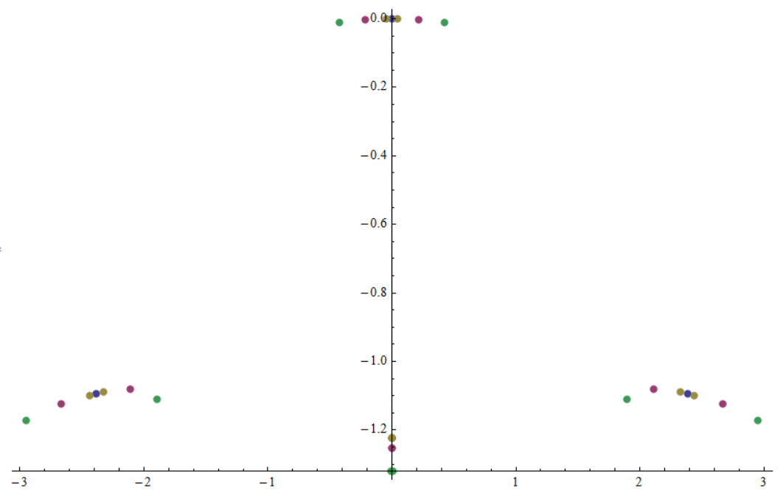
Lower QNMs as a function of B with constant chemical potential (µ=1.8) in spin one mode
Im(𝜔)
Re(𝜔)

Slide 13
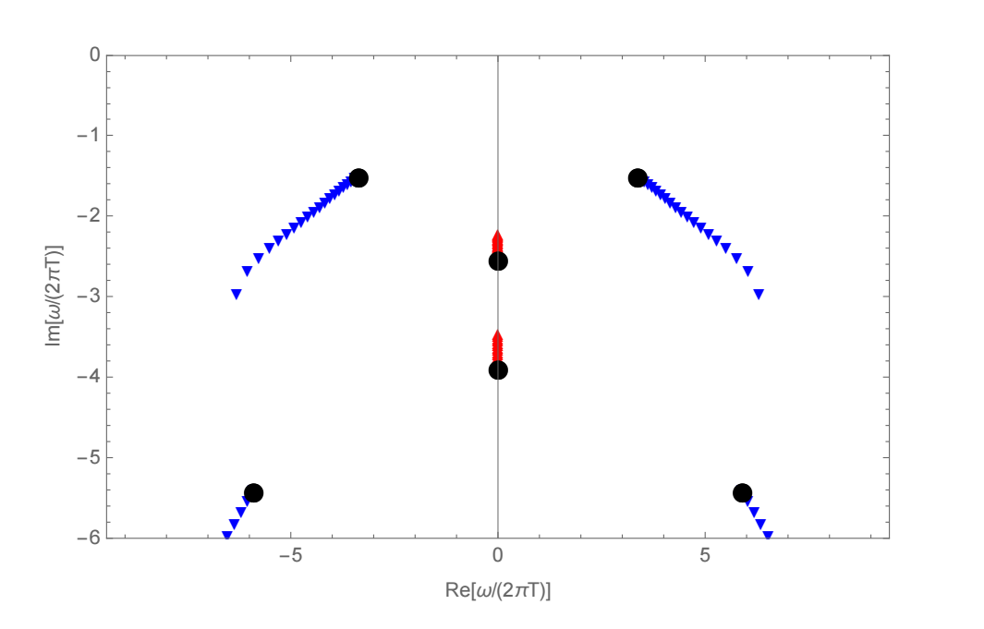
Lower QNMs as a function of charge in Reissner Nordstrom geometry in spin one mode
Hydro mode
Non-hydro modes
Janiszewski & Kaminski (2016)

Slide 14
Discussion
We studied a four dimensional strongly coupled field theory with a chiral anomaly in a charged state, which can be subjected to a strong magnetic field. The presence of the Chern-Simons term in the action gives the possibility to describe chiral transport (chiral magnetic effect), also in strong magnetic fields. There are some “new" modes which become important in the hydrodynamic regime for large magnetic field and non zero momentum.

