Slide 1
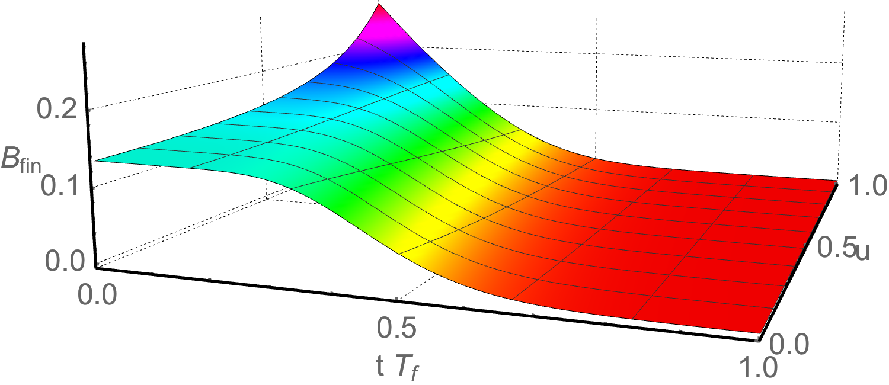
Isotropization of
nonrelativistic plasmas
(and how to calculate quasinormal modes)
Based on 1602.01375
with Umut Gursoy, Watse Sybesma and Stefan Vandoren
Santiago de Compostela,
June 27, 2016
Aron Jansen

Slide 2
Motivation
Nonrelativistic plasmas
A lot of research has been done into the holographic thermalization of relativistic plasmas (the QGP)
Comparatively very little has been done for the nonrelativistic case (ultracold Fermi gases)
While we might have much better experimental control there (see Paul Romatschke’s talk on wednesday!)

Slide 3
Outline
Motivation
Lifshitz black branes
Quasinormal modes
Nonlinear isotropization
Conclusions and outlook

Slide 4
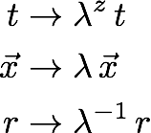
Lifshitz holography
Nonrelativistic dispersion
Lifshitz asymptotics
Scaling symmetry: Lifshitz scaling
Lifshitz black brane:
Need an action supporting such a solution

Slide 5
Action
Taylor (2008)
Einstein-Hilbert term
Cosmological constant
gauge field
massless scalar
coupled to gauge field with
Null energy condition
Parameters (d,z)

Slide 6
Lifshitz black brane
This admits a black brane solution
Horizon at
Temperature
Supporting fields:

Slide 7
Homogeneous Isotropization
Introduce an anisotropy through
The full background now becomes time-dependent
First: linear approximation
small anisotropy
Linearised equation of motion: massless Klein-Gordon equation

Slide 8
Quasinormal Modes
Describe small perturbations around equilibrium
normalisable, infalling perturbations
Discrete set of solutions of the form
Take k = 0
Overdamped: no oscillations,

Slide 9
Quasinormal Modes
Coordinate transformation:
Define:
Equation becomes:
Depends only on !
Universality of (close to equilibrium) isotropization
Notes:
In a system with (d,z) = (4,3) it is the same as for (d,z) = (3,2)?

Slide 10
Quasinormal Modes
Computation
Can be found numerically by using spectral methods
Mathematica package ‘QNMspectral’ to compute any QNM, at http://www.uu.nl/staff/APJansen
Yaffe (2014)

Slide 11
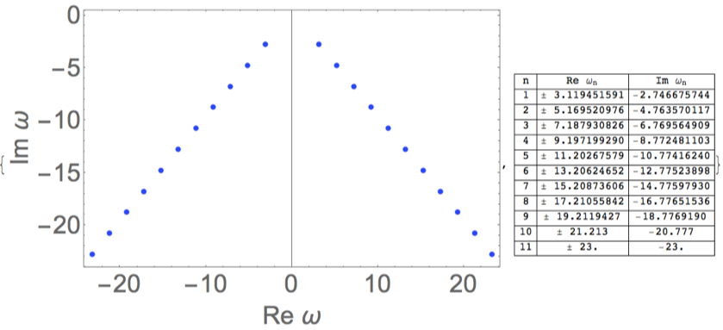
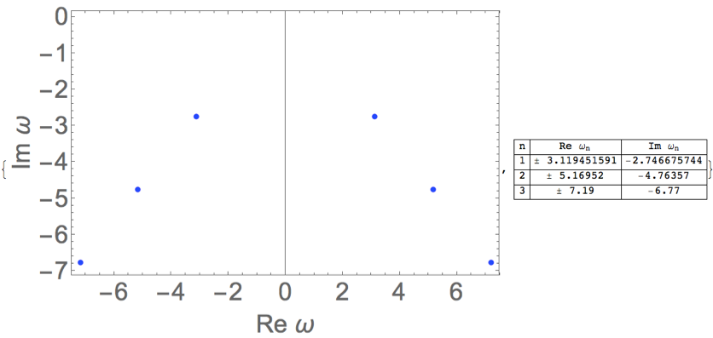
Quasinormal Modes
Computation in QNMspectral

Slide 12
Quasinormal Modes
Computation in QNMspectral
http://www.uu.nl/staff/APJansen
Also works for:
Coupled equations
Frequency occurring nonlinearly
With a numerical background
Higher order derivatives
Any combination of the above

Slide 13
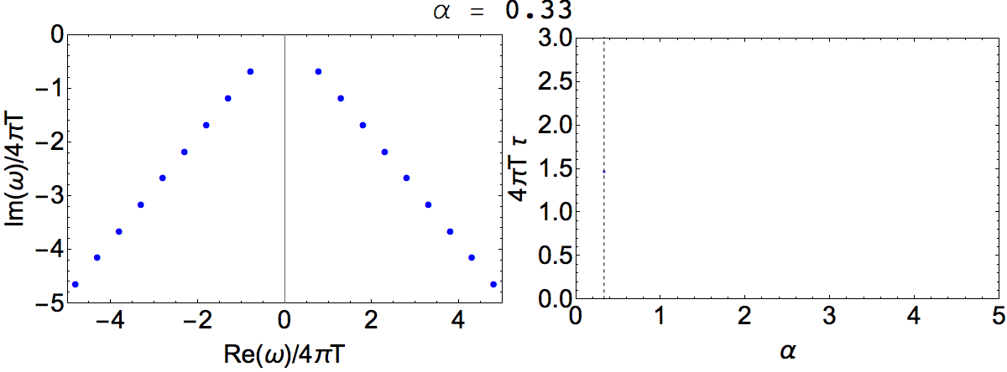
Quasinormal Modes
Quasinormal mode spectrum as increases
Equivalently: starting from , increase z
Relaxation time

Slide 14
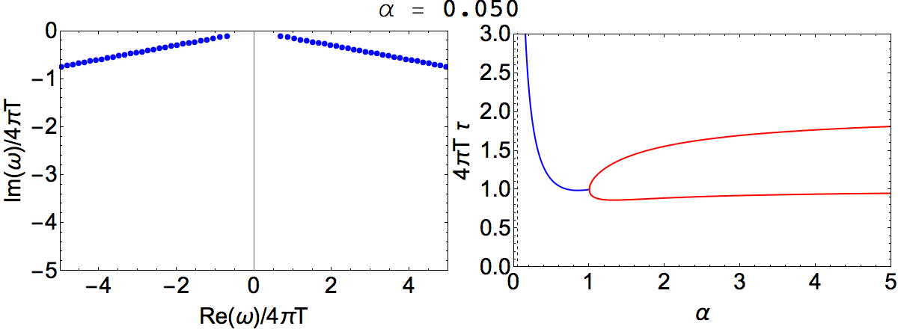
Quasinormal Modes
plots, movie?
All modes become overdamped for

Slide 15
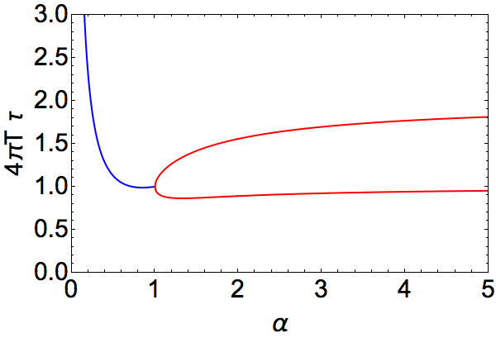
Quasinormal Modes
Overdamped for
Relaxation time decreases as z increases, until , when it increases again
Bounded in narrow range
Sybesma, Vandoren (2014)

Slide 16
Nonlinear Isotropization
Characteristic method: write coupled PDE’s of Einstein-scalar-Maxwell equations as a system of nested, linear ODE’s
This method can be adapted to asymptotically Lifshitz spacetimes
Bondi (1960)
Sachs (1962)
Chesler, Yaffe (2009)
Notes:
constraint eq: radial dervative implied by others, so automatic as long as it holds at the boundary

Slide 17
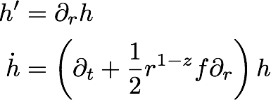
Nonlinear Isotropization
Need a particular coordinate ansatz:
: blackening factor
: anisotropy
: spatial volume
Also need this gauge:
Work with null-derivatives:
Residual gauge symmetry:
Notes:
constraint eq: radial dervative implied by others, so automatic as long as it holds at the boundary

Slide 18
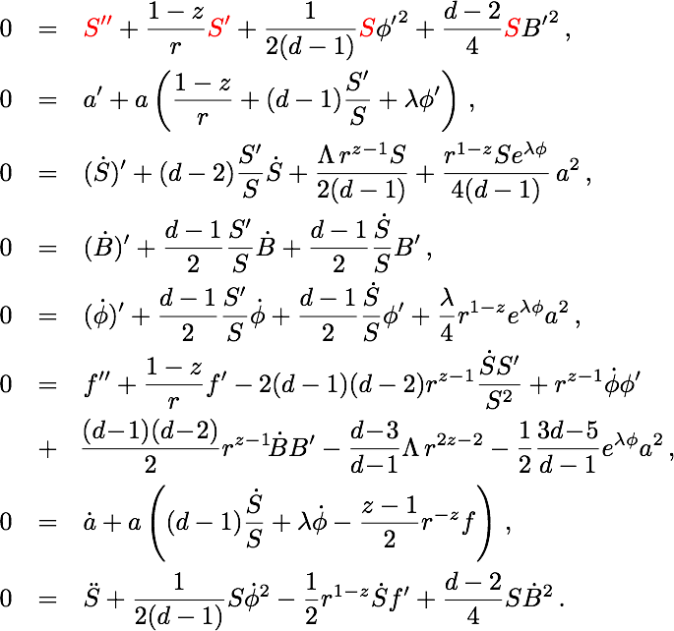
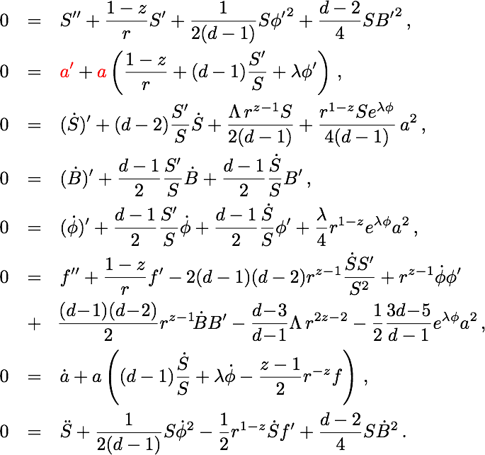
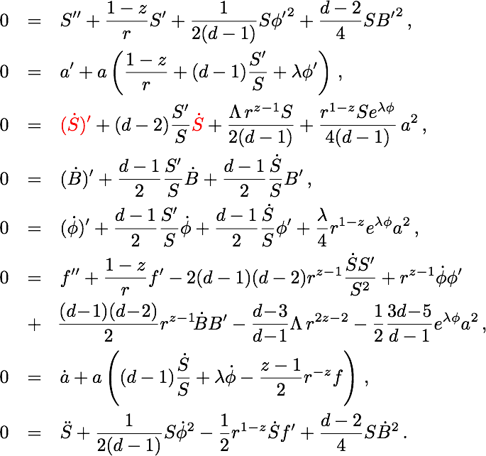
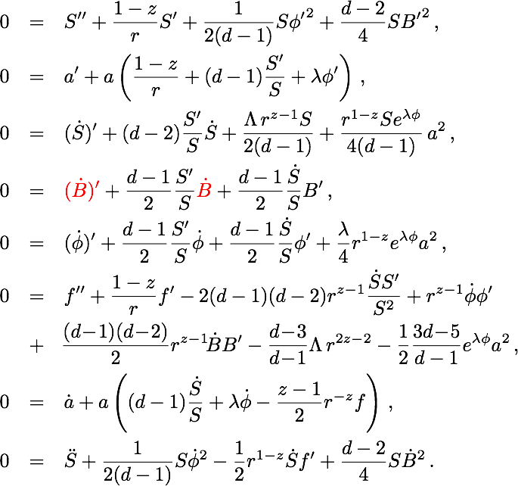
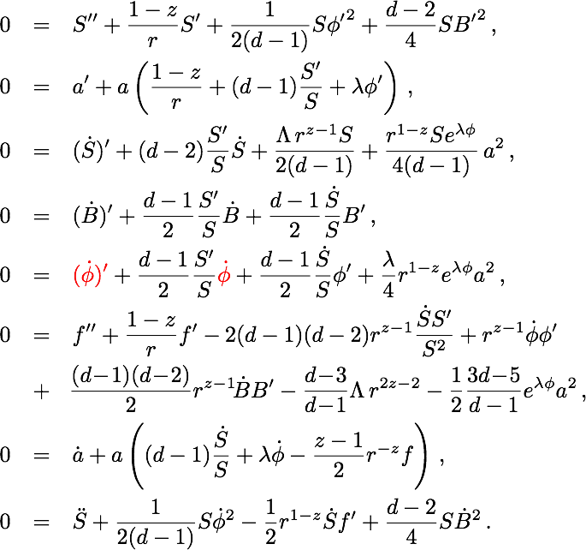
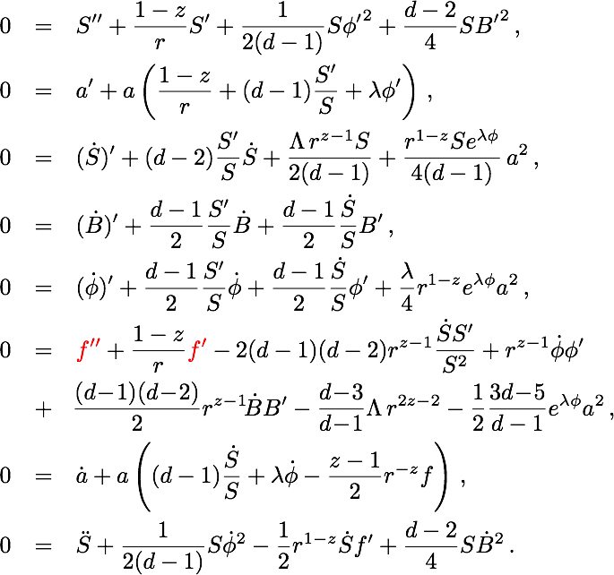
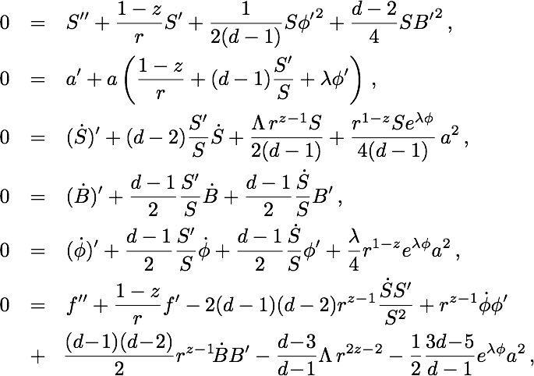
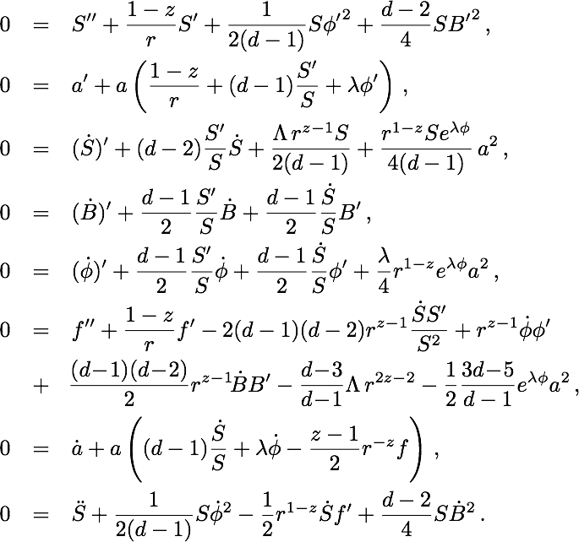
Nonlinear Isotropization
constraint
equations
Notes:
(217,121) (685,642)

Slide 19
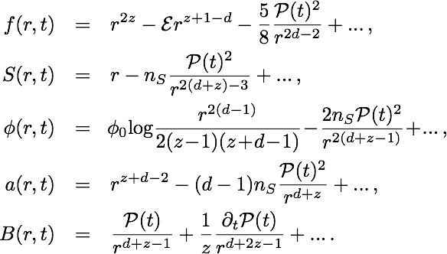
Near boundary expansion
Only dynamical mode is
Additional scalar and gauge field have no independent dynamics!
No sources
Notes:
(217,121) (685,642)

Slide 20
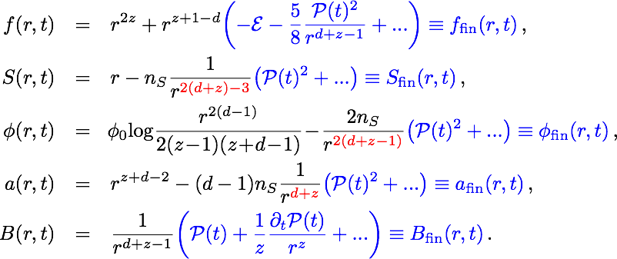
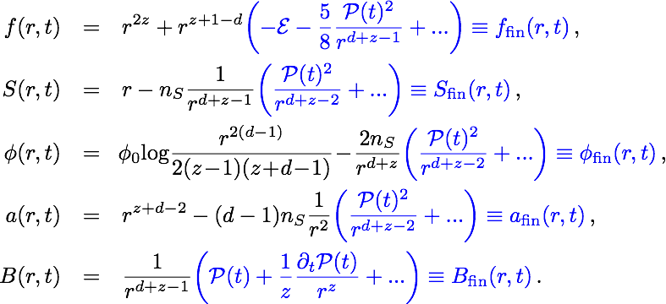
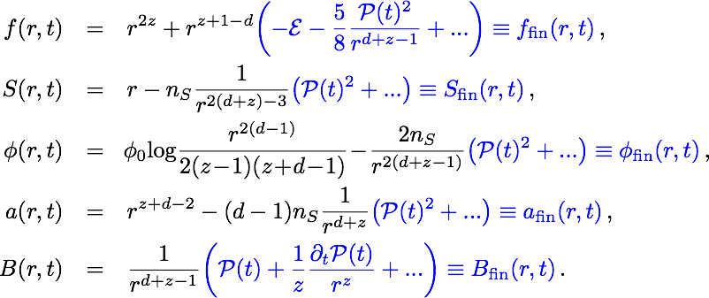
Near boundary expansion
Have to be careful in making them finite for numerics
Usually (in AdS) starting with the first normalisable mode works
For and a doing this leads to unstable equations
rescaling differently greatly improves stability
Finally do a coordinate transformation

Slide 21
Renormalisation
Kiritsis, Matsuo (2015)
Counter-term
Energy-momentum tensor
Satisfying the Ward identity
Pressure anisotropy
Conserved energy
No dynamics in , : both constants
Notes:
(217,121) (685,642)

Slide 22
Nonlinear Isotropization
Initial conditions
To compare different (d,z), fix
Subtlety due to Lifshitz asymptotics: We have to specify both and , while is determined by B
To deal with this, plug in and in the near boundary expansion, to order
Finally fix so that
Notes:
(217,121) (685,642)

Slide 23
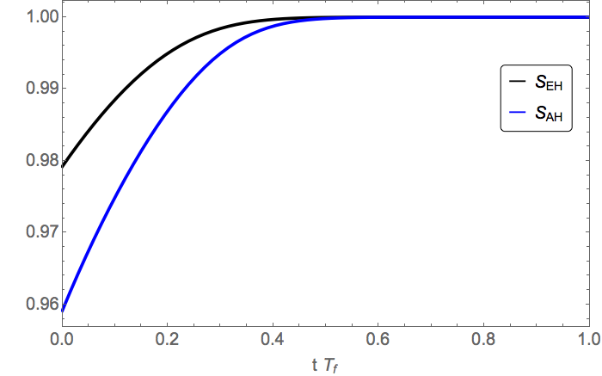
Nonlinear Isotropization
Example: d=4, z=2
Pressure isotropizes as
Horizon area monotonically increases
Notes:
(217,121) (685,642)

Slide 24
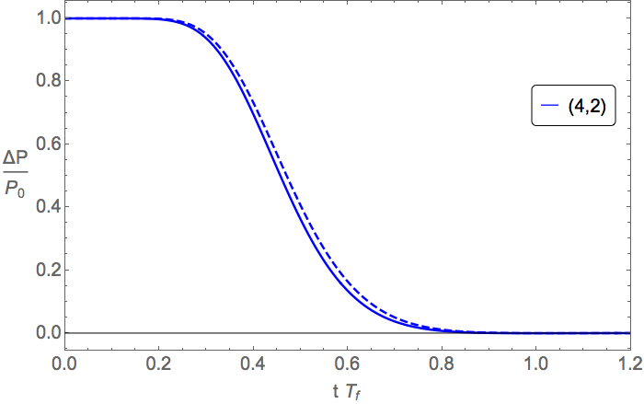
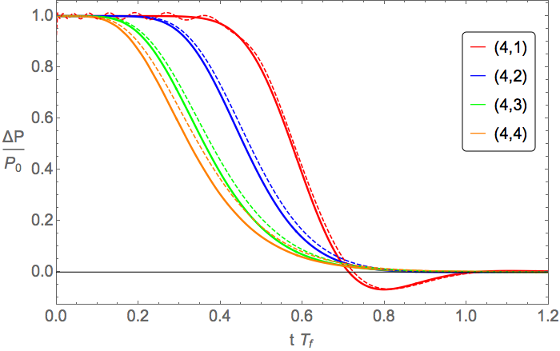
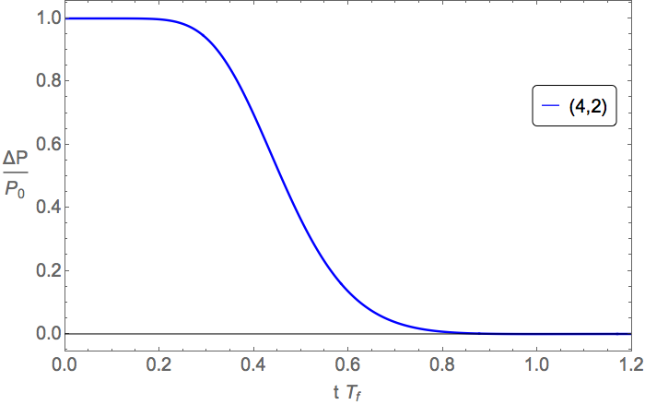
Nonlinear Isotropization
(d,z)
Fit initial profile with first 10 QNM’s
dashed lines: evolution of
Heller, Mateos,
van der Schee,
Triana (2015)
Notes:
(217,121) (685,642)

Slide 25
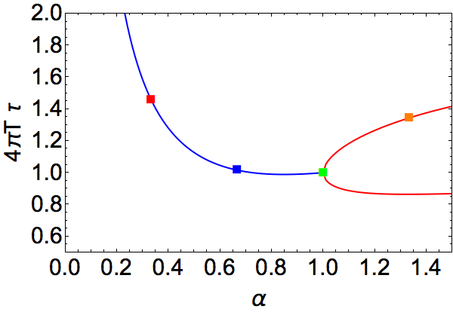
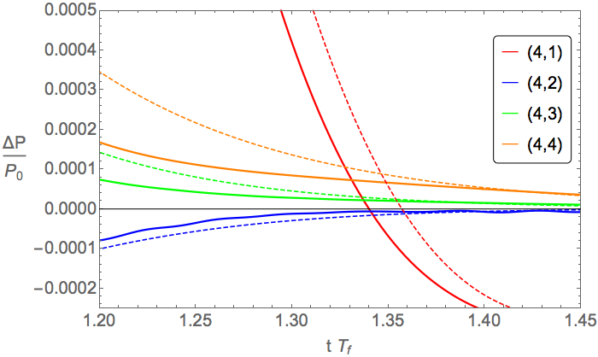
Nonlinear Isotropization
(d,z)
Zoomed in, comparison with relaxation time
Notes:
(217,121) (685,642)

Slide 26
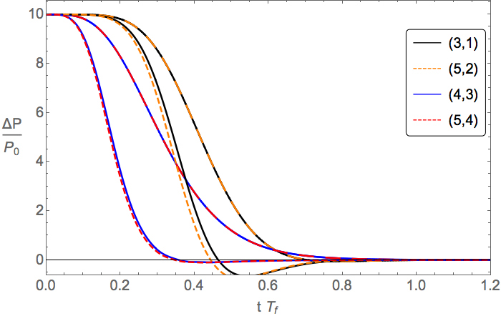
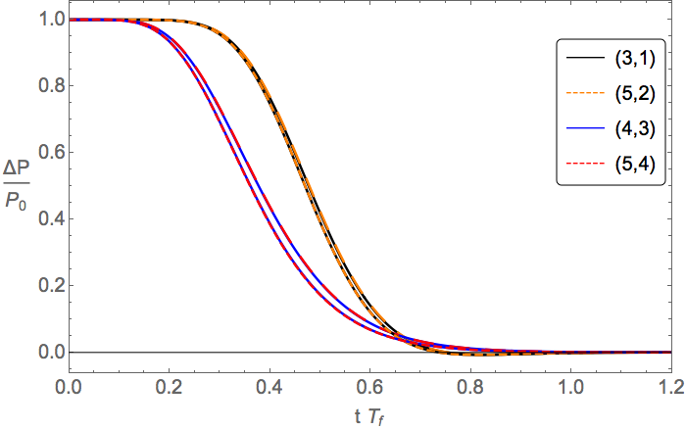
Nonlinear Isotropization
(d,z)
QNM
QNM
nonlinear
nonlinear
Compare different (d,z) with the same
Virtually identical!
Even for larger initial conditions, which are not well described by a QNM fit!
Notes:
(217,121) (685,642)

Slide 27
Conclusions
At the linearised level, isotropization is universally characterised by the ratio alpha
This seems to persist in the nonlinear regime, even when quasi normal modes do not provide a good description
Evolution becomes overdamped for
increasing z from 1, relaxation times first decrease, then increase again after
Open questions
Connection to experiment? See Paul Romatschke’s talk
What about different Lifshitz models?
Thank you!

Slide 28
QNMspectral
The method
Yaffe et al. (2015)
A QNM equation is an ODE :
In Eddington-Finkelstein coordinates, the infalling boundary condition at the horizon becomes regularity
Rescaling the function appropriately, normalisability at the boundary becomes finiteness
Discretising r and writing as a sum of Chebyshev polynomials, the equation becomes a matrix equation , with boundary conditions automatically satisfied

Slide 29
QNMspectral
The method
In simple cases, as in this talk, , so the equation becomes .
This is a generalised eigenvalue problem, solved in Mathematica simply by Eigenvalues[{A,B}].
If it is not linear, it can always be made linear
Alternatively, one can sweep the complex -plane looking for zeroes of .
You may have a coupled system of equations, or the background may be numerical, this will still work.

Slide 30
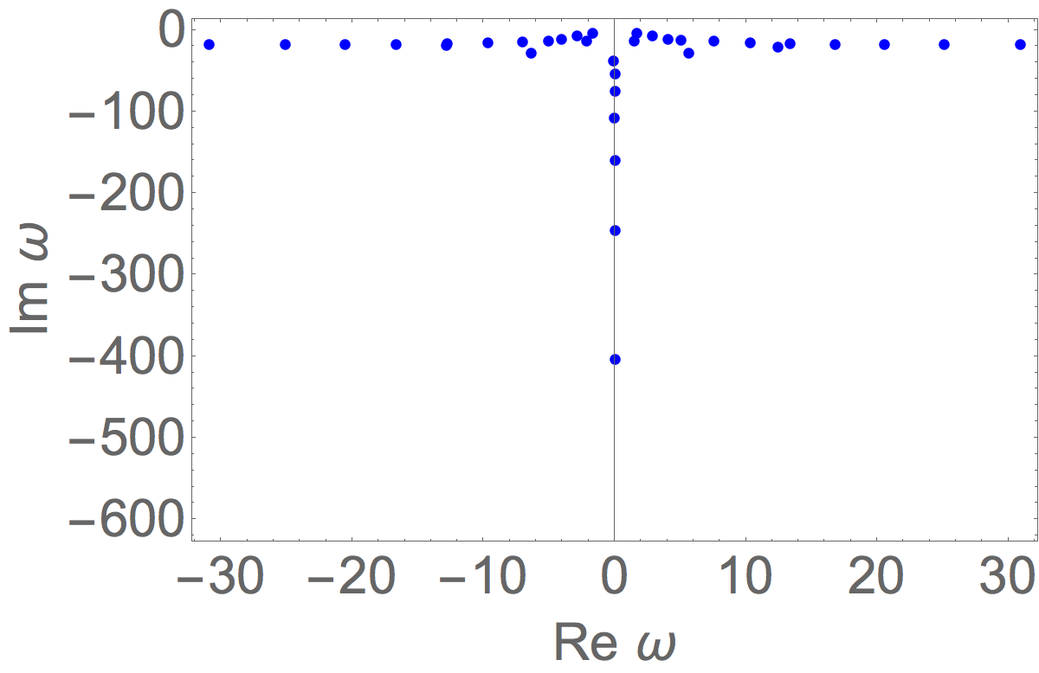
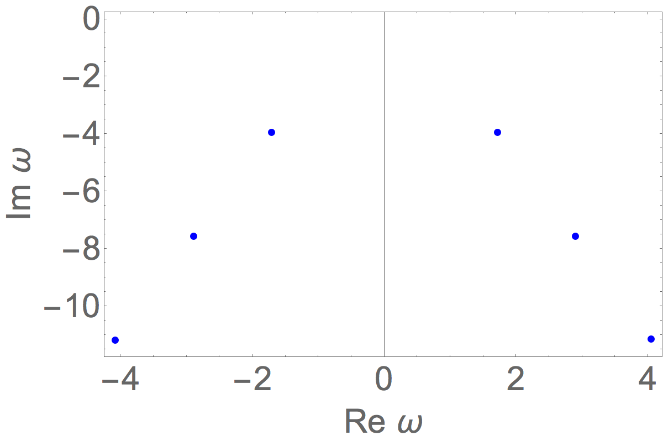
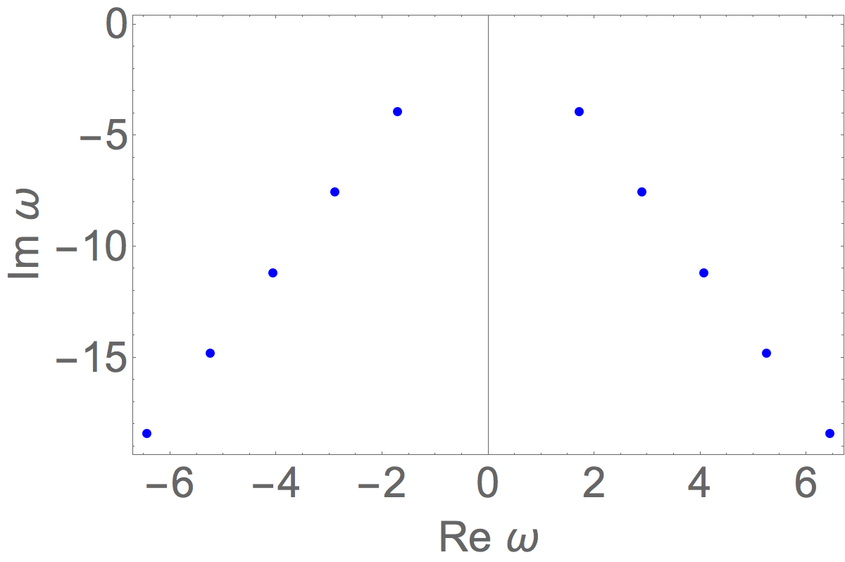
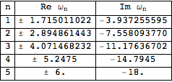
QNMspectral
The package
http://www.uu.nl/staff/APJansen

Slide 31
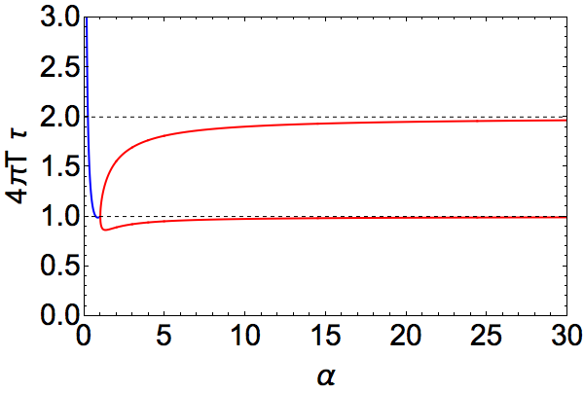
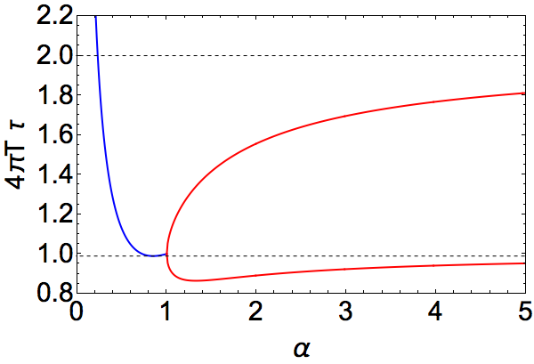
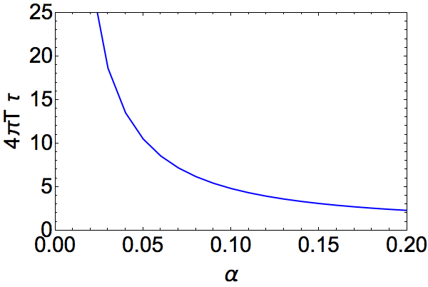
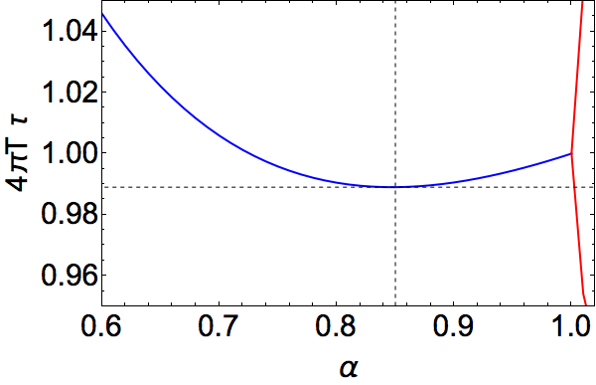
Quasinormal Modes
Overdamped for
limit:
Tiny dip at , where
Relaxation time bounded by
as (or )
Sybesma, Vandoren (2014)

